Slide 1
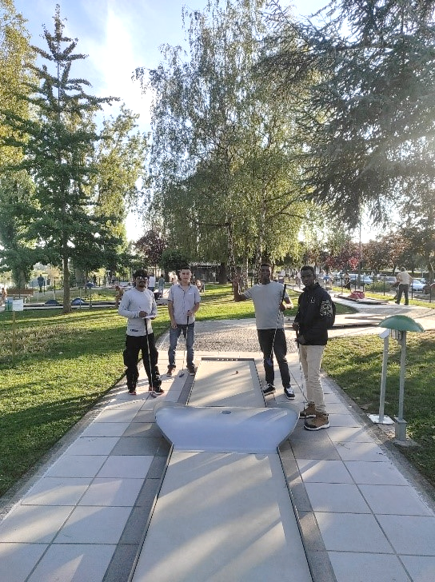
MOTIRÕ (with the support of AMIF) A project which, through a variety of activities for about 240 young refuges, provides social support and helps to improve mental health.
Findings | Response
Loss of confidence in themselves and others | Good ear of the responsible Discover new skills and gain in self-confidence
Worry about the future | Good ear of the responsible. Share their difficulties with the people in charge and with other young people
Loss of meaning in life | Good ear of the responsible With activities proposed every Saturdays and with short stays during each vacation period. Activities and short stays improve well-being Good contacts with socio-educational team of the accommodation facilities (for psychological accompaniment, social needs, medical treatment etc.)

Slide 2
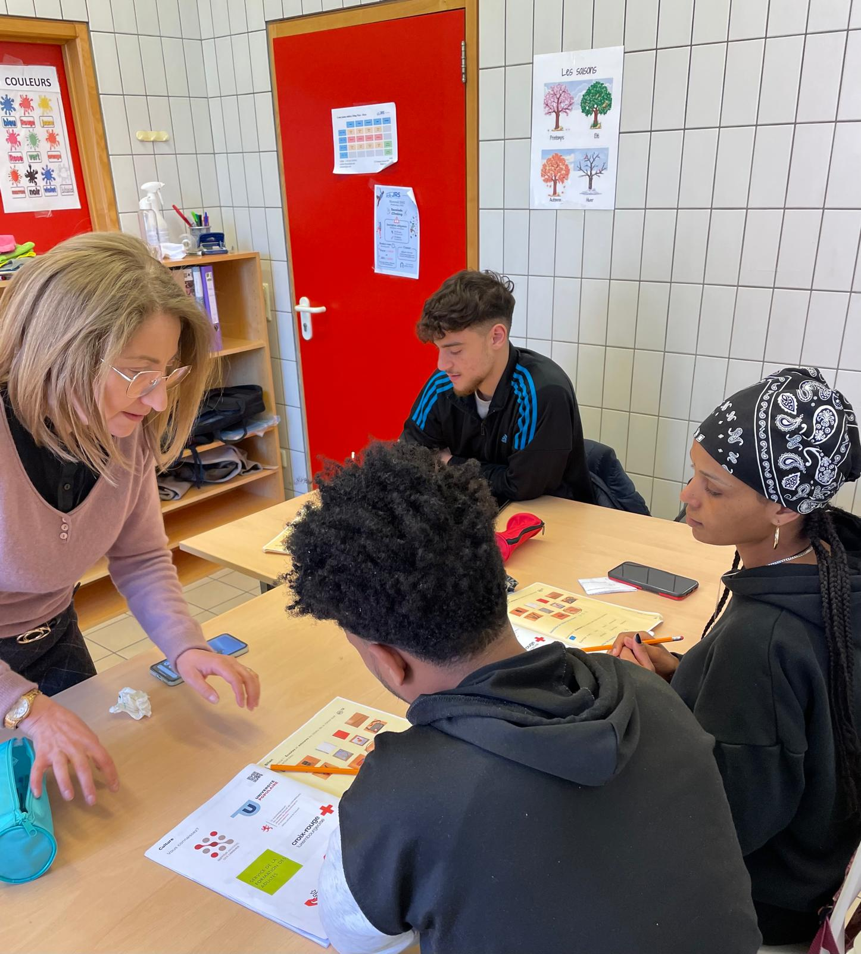
KARIBUNI (with the support of Œuvre Grande-Duchesse Charlotte)
A project to support for about 100 young asylum seekers aged 13 to 24 on the road to sclararization.
Findings | Response
Vacancy for young people waiting for a place in classes | French classes and activities
Communication problems | French classes 4 times a week Summer camp (3 weeks with French lessons and activities every days)
Comparison and misunderstanding between asylum seekers | Opportunity to explain their different statuses. Search for solutions with the permanent staff
Competition for the same work placements between young refugees and other young people who are more integrated in Luxembourg | Coaching: help with identifying career options, help with CVs and covering letters, preparation for tests and interviews
Slowing down of the integration process due to prolonged stays in accommodation facilities, sometimes geographically distant and isolated | Offer to take part in Motiro's activities Regular contact with accommodation teams. Personalised follow-up (+/- 5 times a year)

