Slide 1
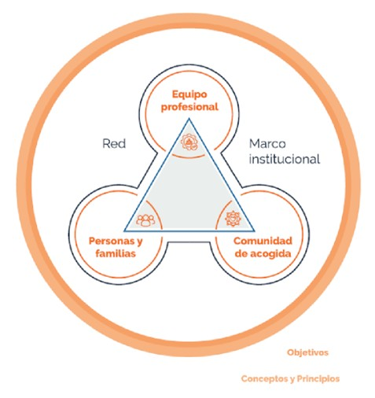
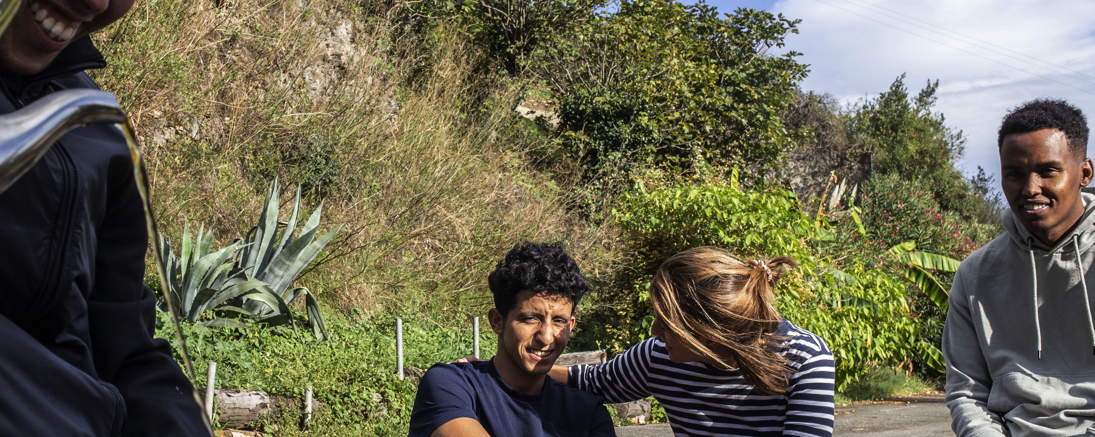


Hospitality
Values
Heart and head for structured, sustainable and effective solidarity.
2.000 people hosted in a network of 1.600 volunteers
Lessons Learned for building Hospitality projects
Binding together
Recognition of rights & generation of opprotunities
Networking
Encounter and reflection
Flexibility
Research and systematization
Concepts & principles
Professional Team
Net
Institutional Framework
Migrant people
Welcome Communities

Slide 2
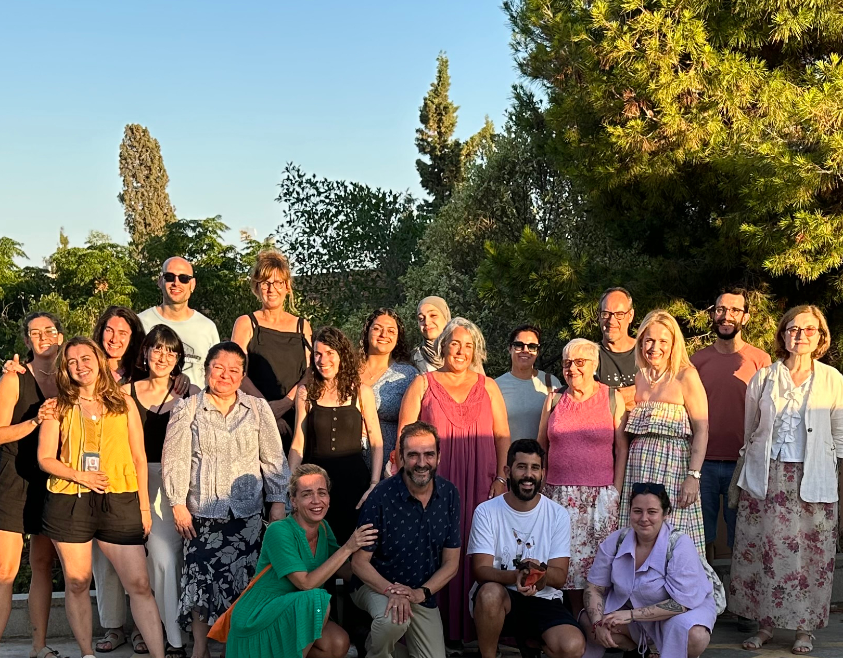
Identity & mission training in the Social Apostolate
Identity & Mission | Transversal Comp. | Specific Competences
Identity | Advocacy in Ignatian Institutions. | Psychosocial intervention
Contemplation of reality | Safe environment | Transculturality
Accompaniment | Organisational Well-being & satff care strategies | Antiracism
Ignatian Leadership |  | Legal frameworks
Lessons learned:
Share experiences & build reflection over intervention
Develop apostolic body & alliances
Strengthen core values & common model of accompaniment
Staff care and skilling

