Slide 1
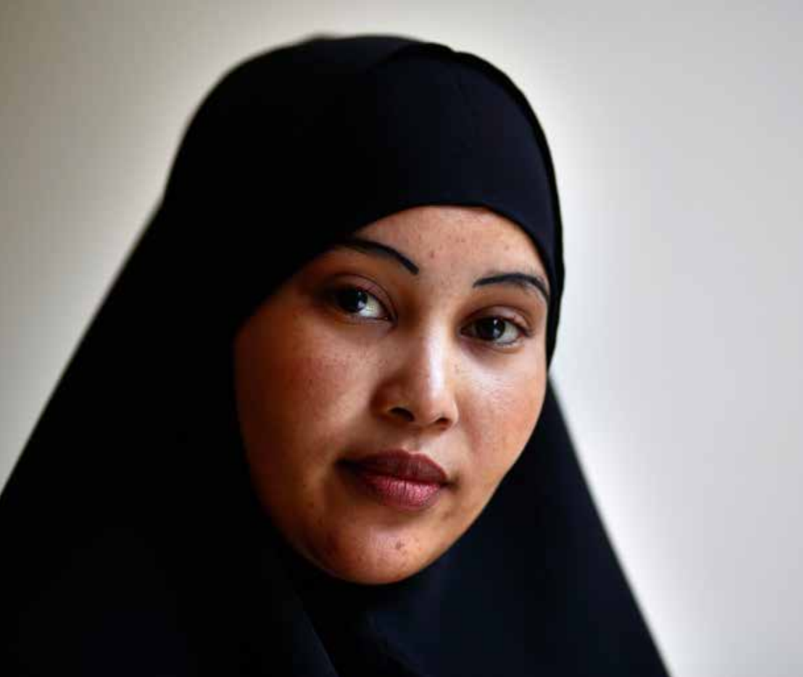

No Giving Up
Importance of advocating not only for but with refugees
Impact of first-hand testimonies, storytelling
Building trust through faithful accompaniment (8 sessions in detention; 3 once women were released)

Slide 2
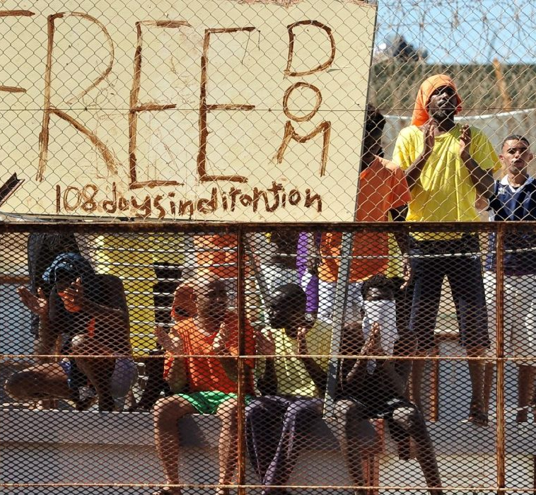
Detention visiting (currently under Project Integrated)
Going where the need is greatest and attending needs that others are not attending to.
The value of perseverance and long-standing commitment (building experience and expertise)
Going to detention when authorities are doing their best to keep us out is an act of meaningful resistance against a system which intentionally isolates, excludes and discards people.

