Slide 1
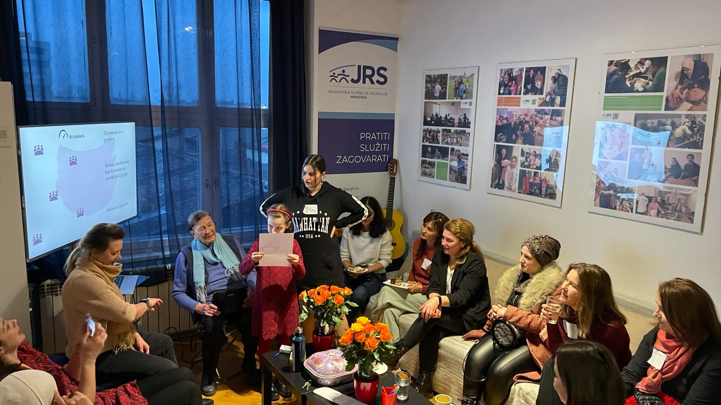
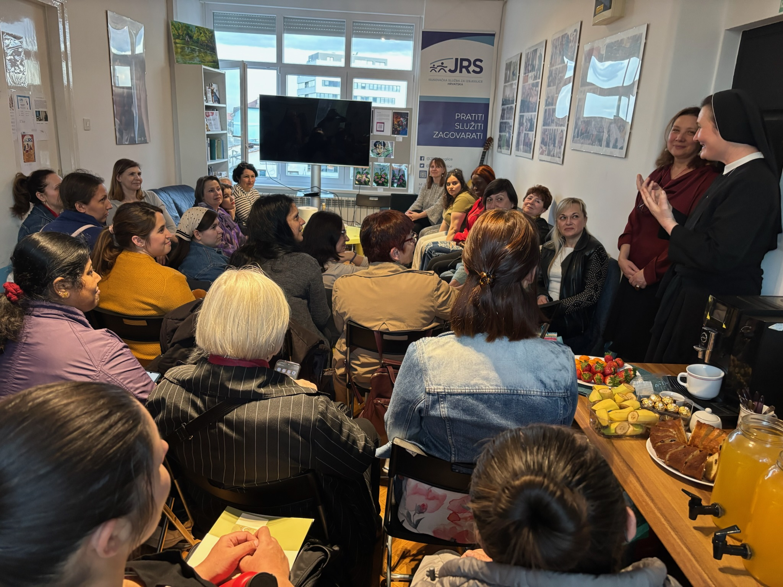

Empowerment for Employment (2023 – present)
This project, launched in 2023, aims to empower refugees and migrants by offering a comprehensive support system that includes:
Psychological support and legal counseling
Employment mediation and workplace rights workshops
Cultural mediation and language courses for better integration
Skills recognition, vocational retraining and diploma validation
One of the key strengths of this project is the collaboration between a diverse coalition of stakeholders, including private sector companies, and NGOs. In partnership with UNHCR, we have created a model that not only addresses immediate needs but also supports long-term integration and career development. It helps people reclaim their dignity, build sustainable futures, and even pursue careers they once had—or dreamed of—in their home countries.

Slide 2
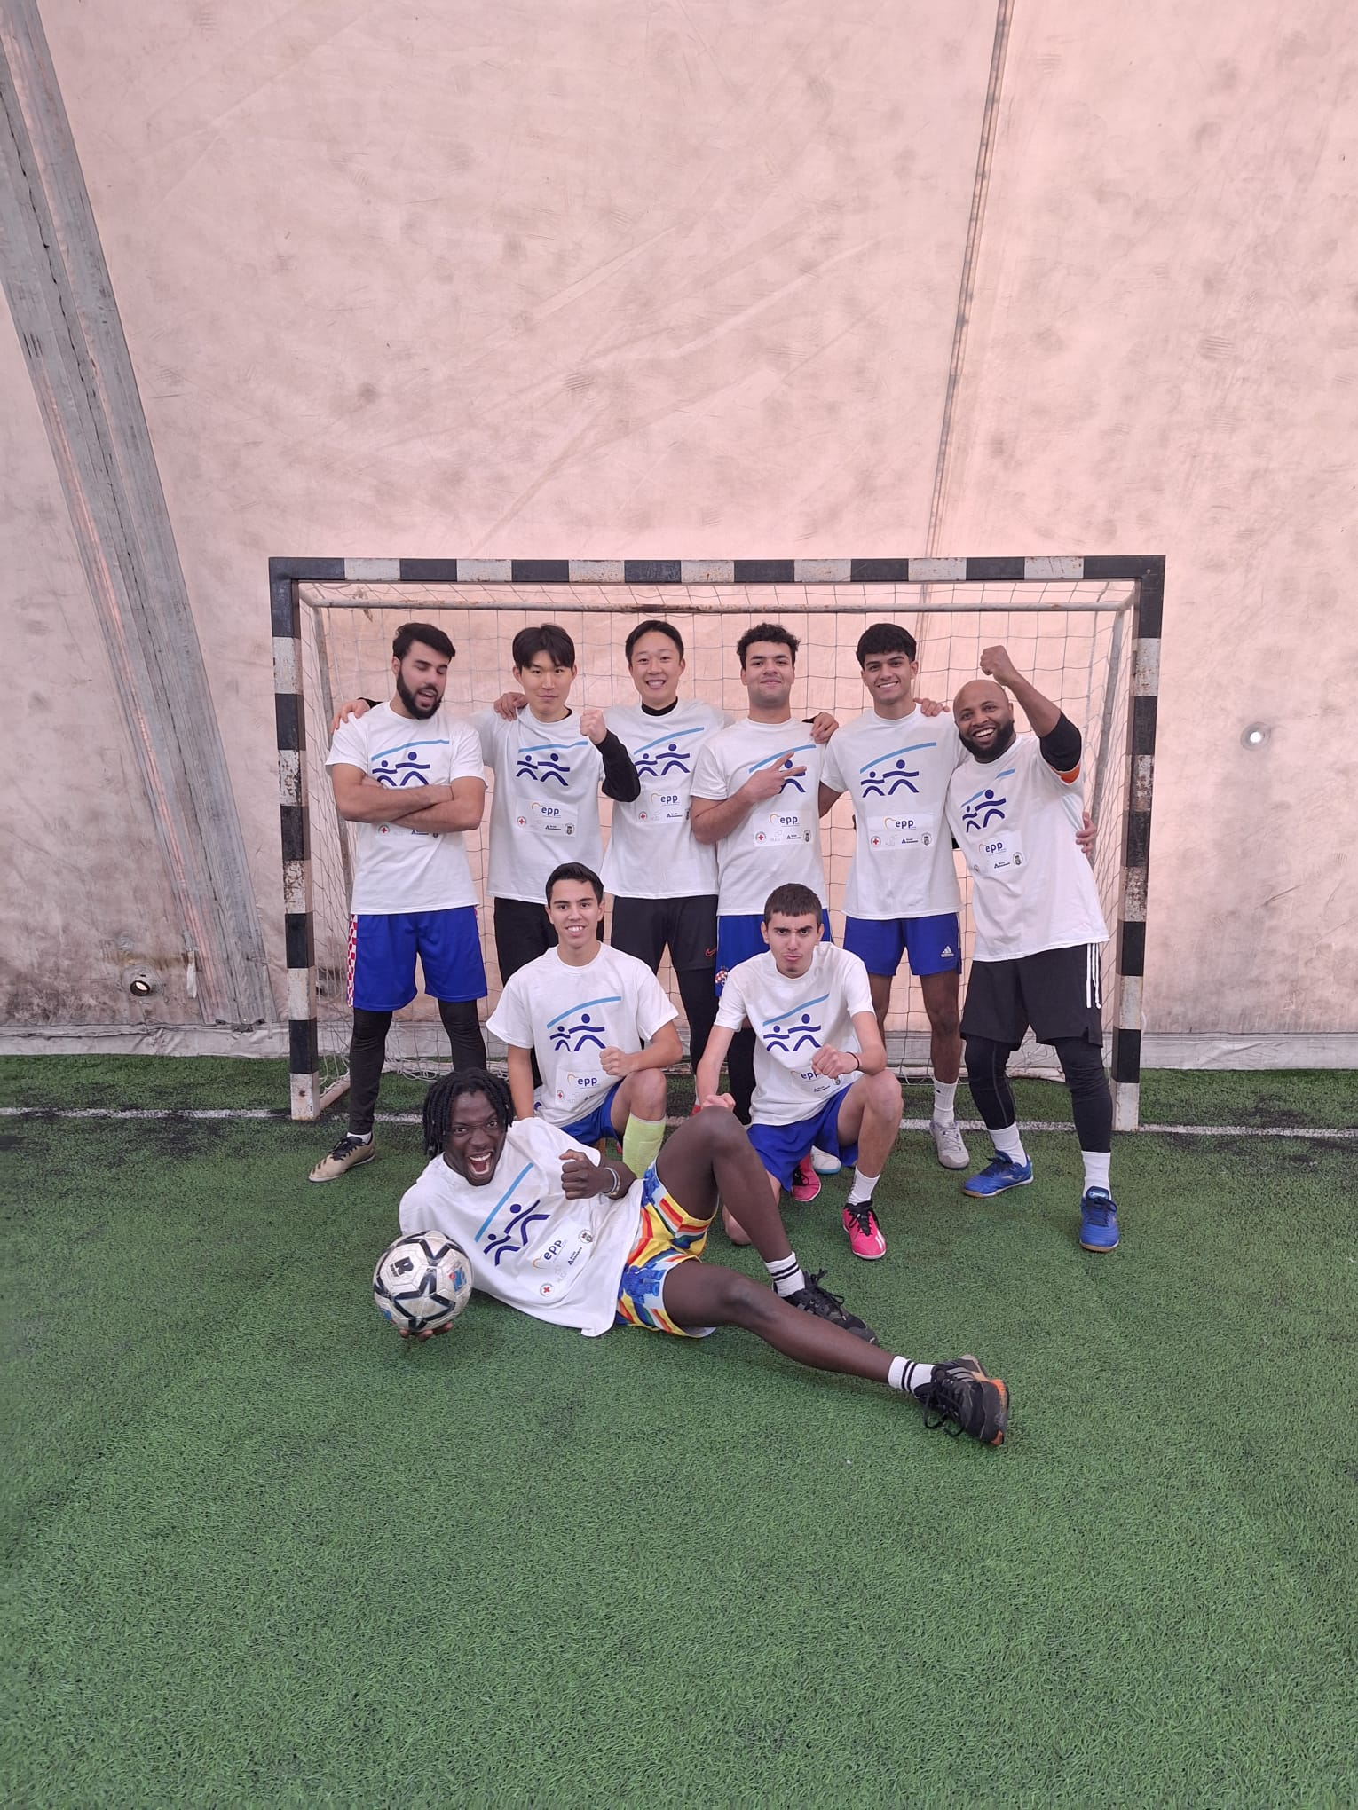
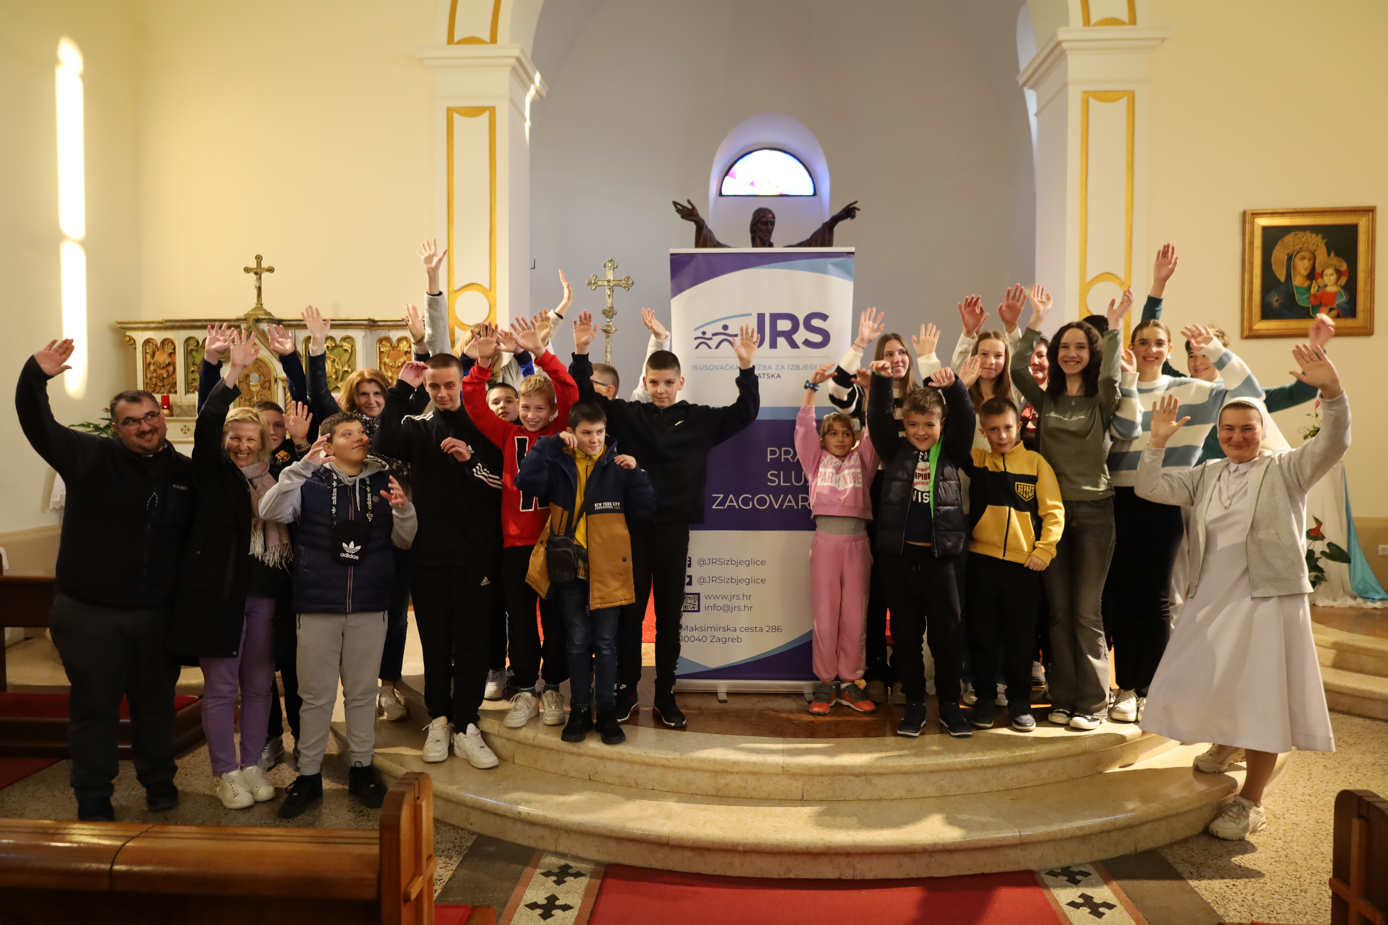
Parish-Based Refugee Reception and Integration (2022 – 2026)
This ongoing project utilizes the capacities of Catholic parishes to welcome and integrate refugees into the local community. Initiated in 2022 and extended until 2026, it serves as a bridge between Croatian citizens and migrants. The key components include:
Opportunities for cultural exchange and mutual learning through parish activities
Breaking down stereotypes and prejudices by fostering genuine human connections
Providing spiritual support and encouraging a sense of belonging
This model encourages host communities to embrace change with compassion and helps refugees to avoid isolation and ghettoization. By meeting in a faith-based, welcoming space, both sides experience the power of encounter, empathy, and shared humanity.

