Slide 1
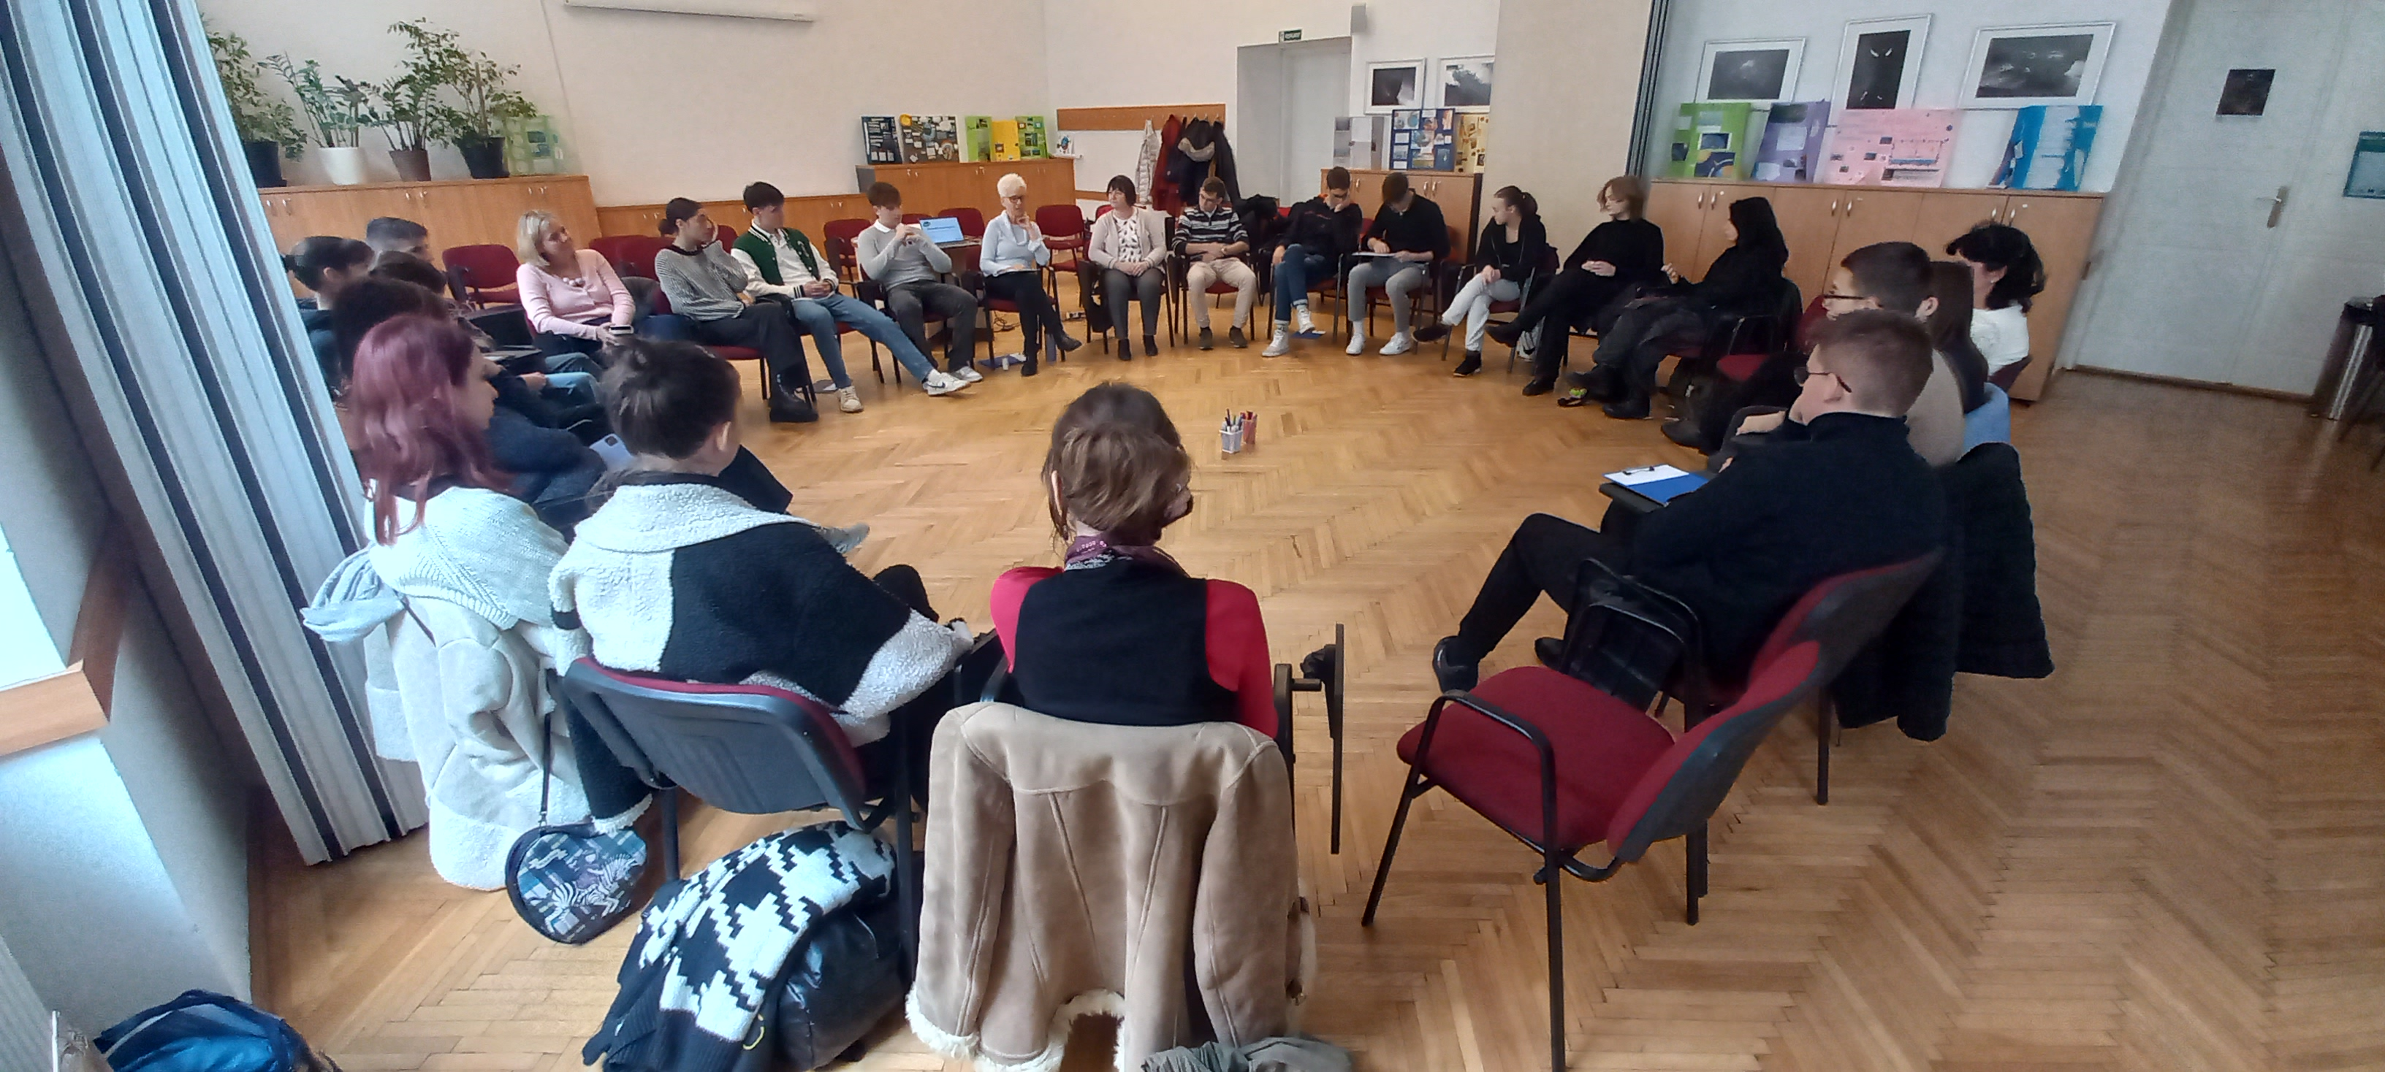

CHANGE projects
WHAT?
Raising awareness activities on „migration” in high schools.
WHY?
Migration is a heated topic.
Heads of schools refuse to tackle the issue.
Increasing level of xenophobia.
HOW?
Switching the focus to „climate change”.
Performing it instead of schools… ☹
Speakers’ key role.

Slide 2




Zahra and Zia HFL package
WHAT?
Language learning package
(complemen-ted by teacher workshops)
WHY?
Lack of methodologi-cal tools, personnel, and central administrati-on (in this sense).
HOW?
Based on needs.
Development of tools and sharing it for free.
Selling the booklet and using the income for re-printing.

Slide 3
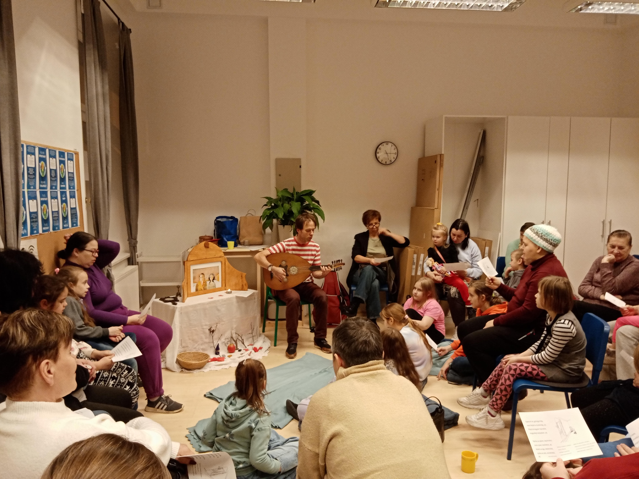
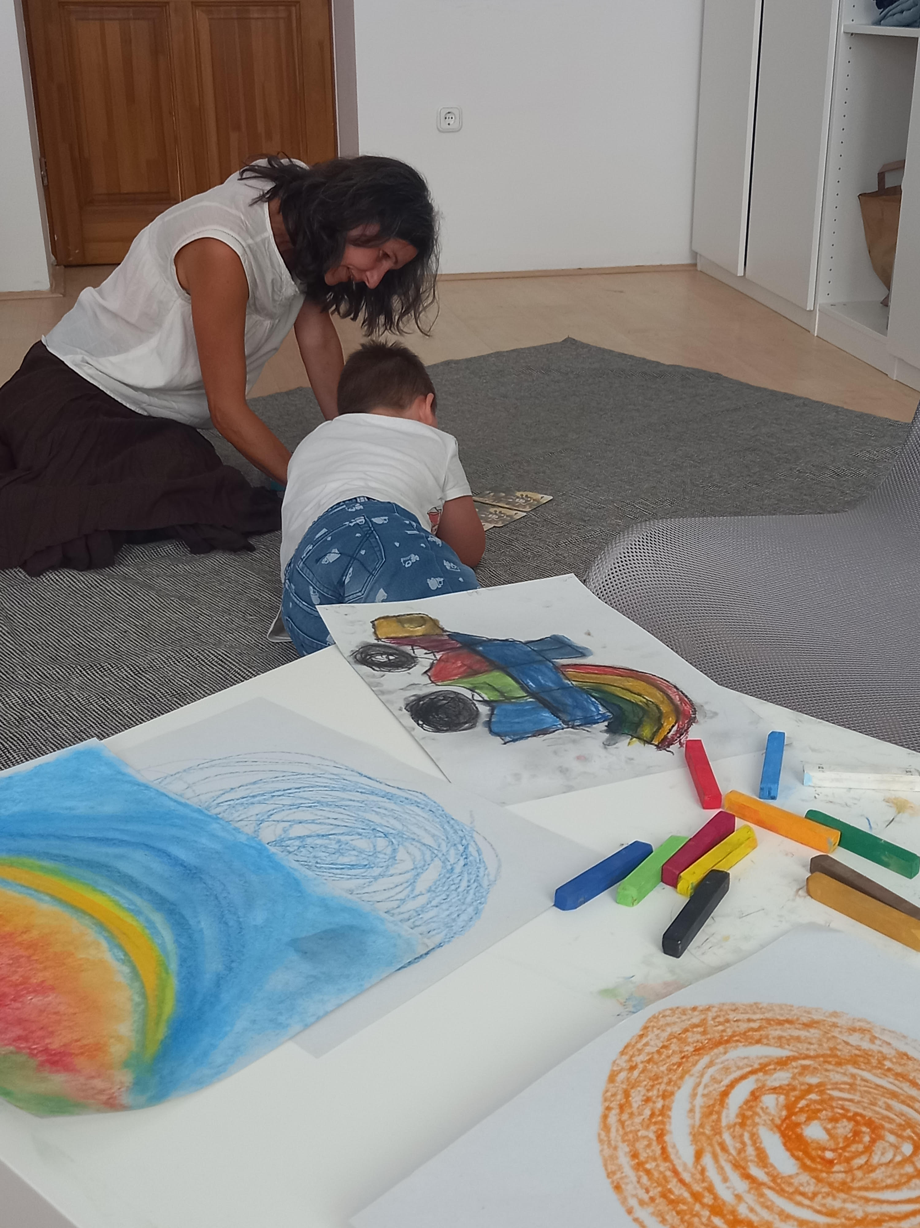
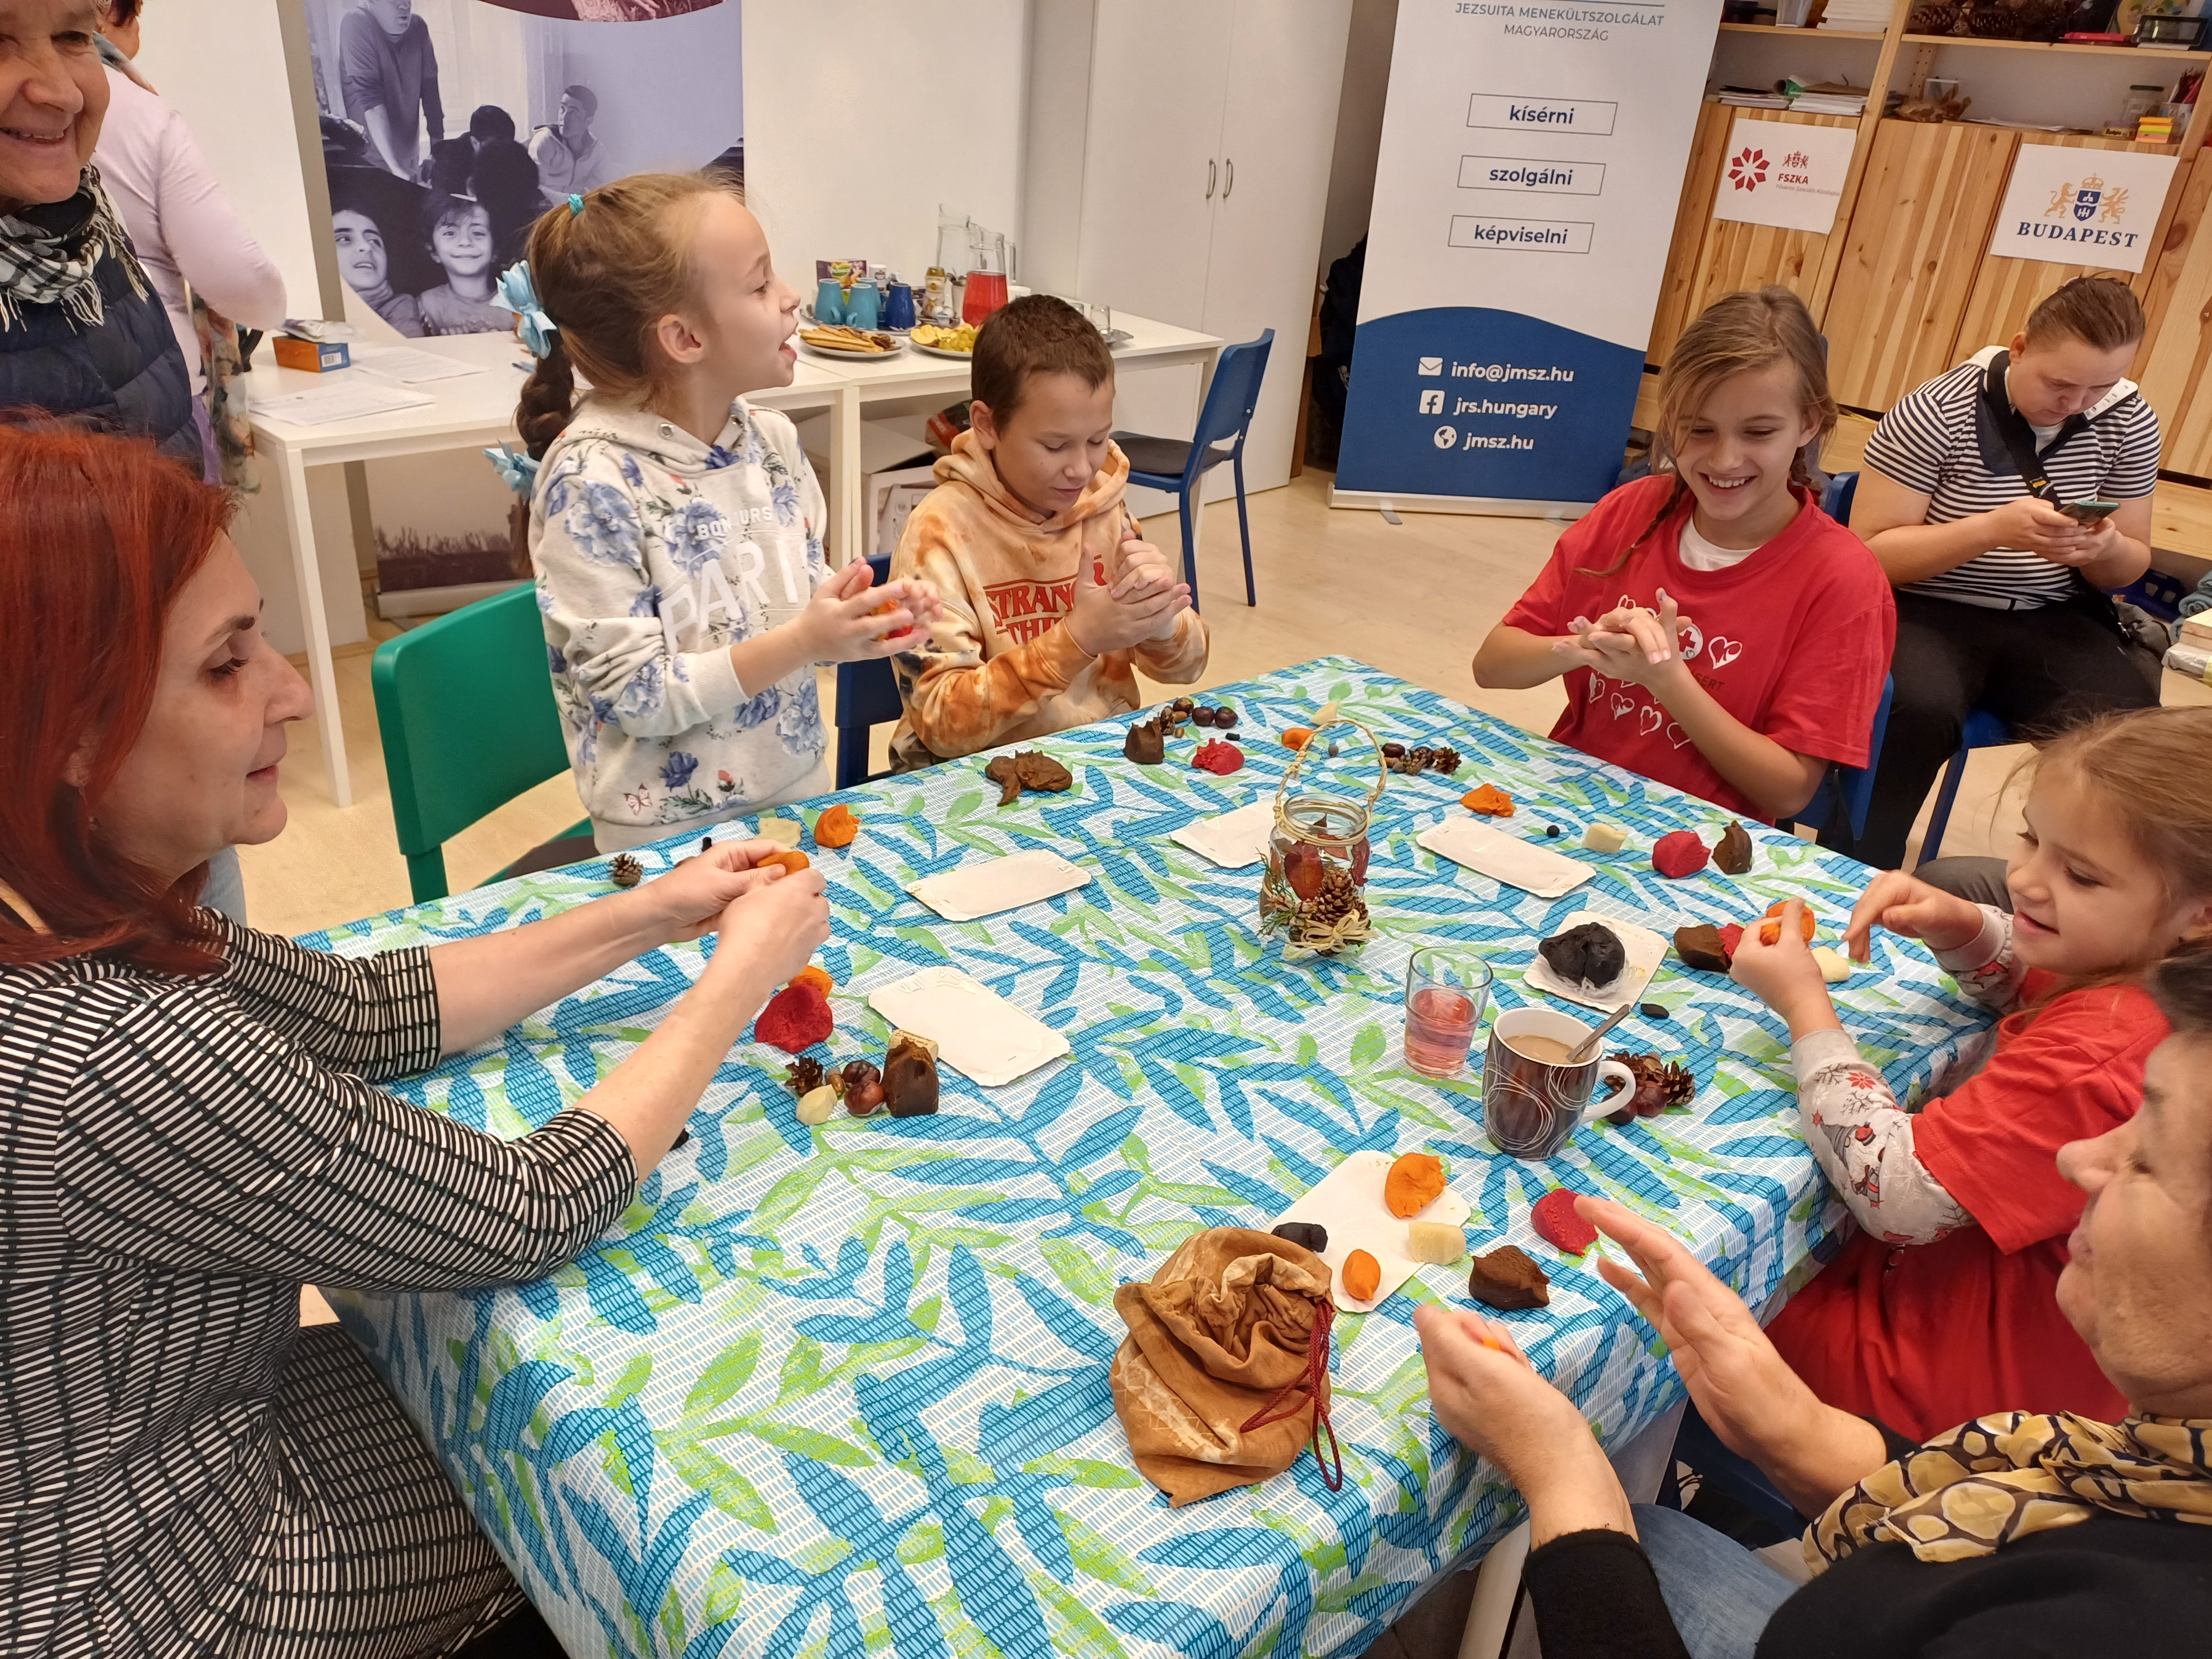
Mixing methods – by JRS TEAM
WHAT?
Services for minors using mixed approaches:
MHPSS +
Language +
Development.
WHY?
Lack of services.
Multifaceted needs being assessed (SEN).
Time consu-ming process of diploma certification.
HOW?
3:1 expert (teacher and 2*developer)
Cooperation with experts coming from Ukraine
Cura personalis.

