Slide 1
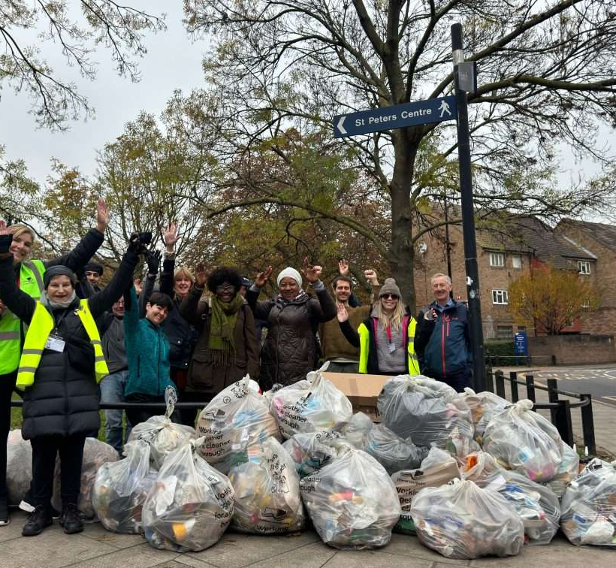

Community and Reconciliation Project
Commitment and intentionality
Meeting people where they are.
Space for reflection

Slide 2
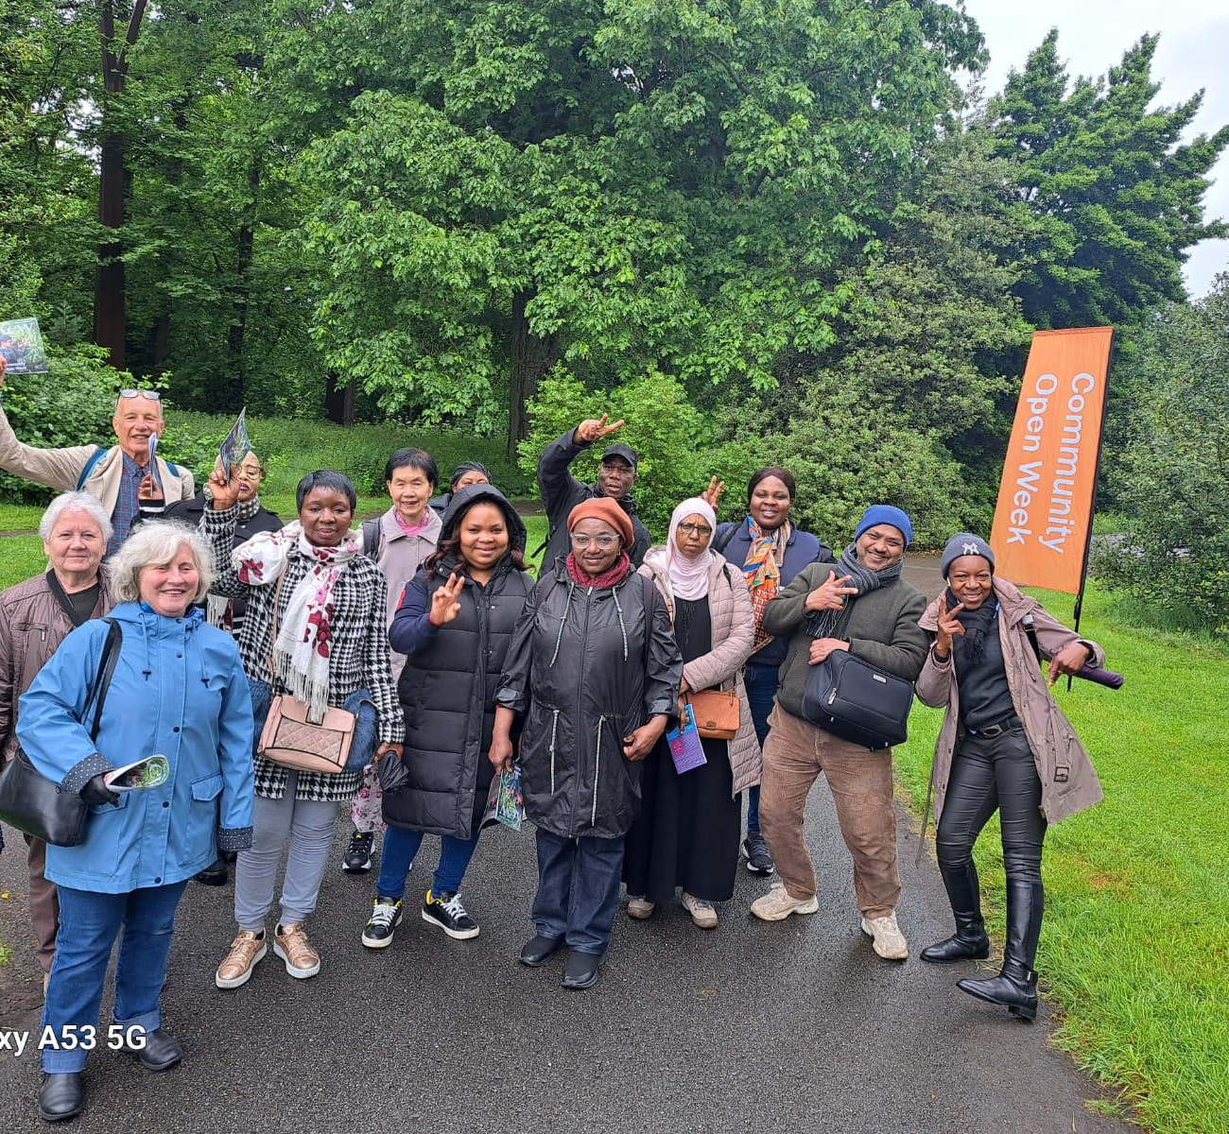
Befriending Project
Openness, trust and empathy creates space for meaningful encounter and long-lasting positive relationships no matter the format.
Impact of clearer guidelines

