Slide 1
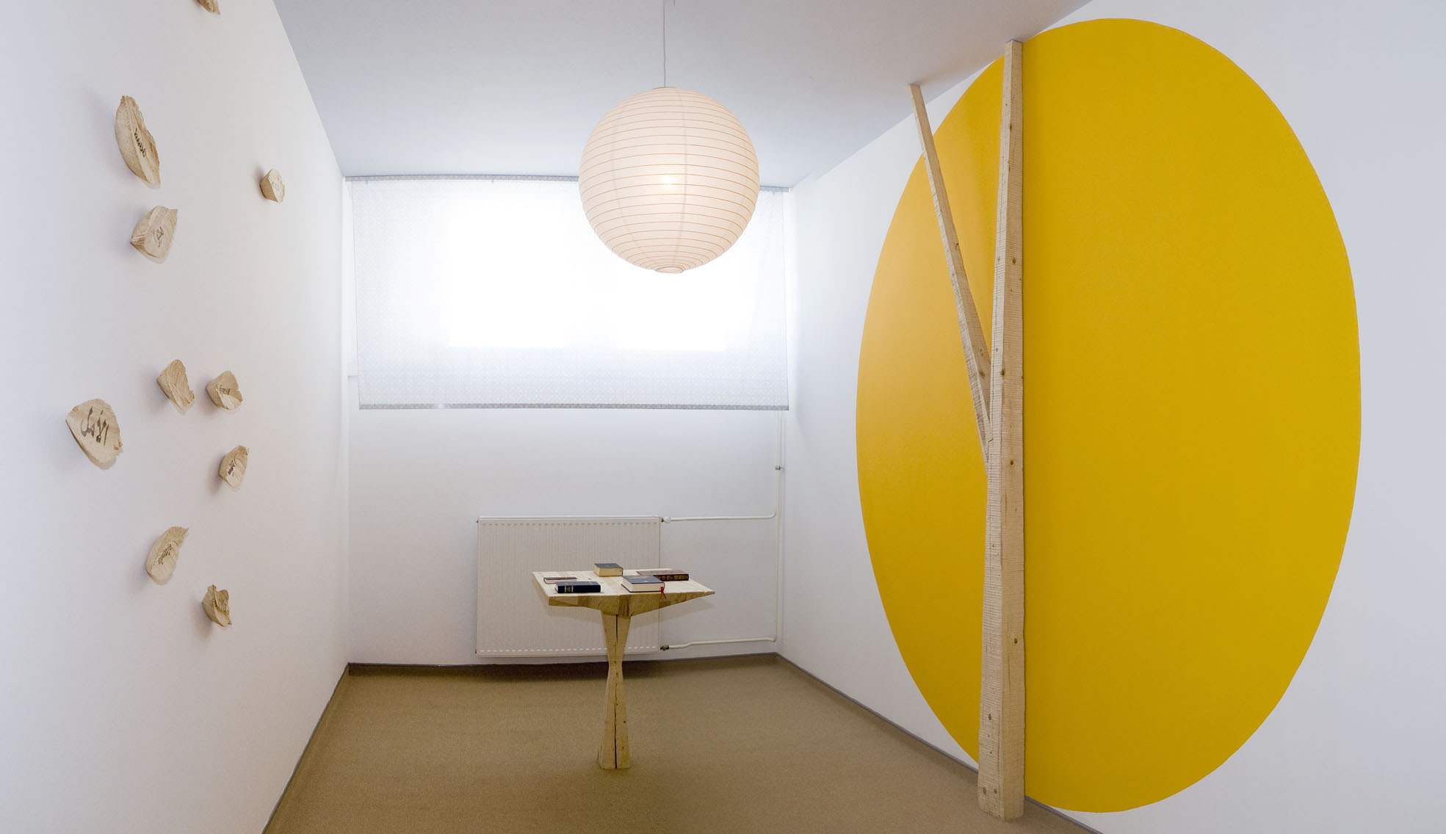

Pastoral work: serving the detaines
Creation of the Room of silence (2008)
Serving the spiritual needs of the detaines
Celebrating the mass for the detaines and other people .

Slide 2
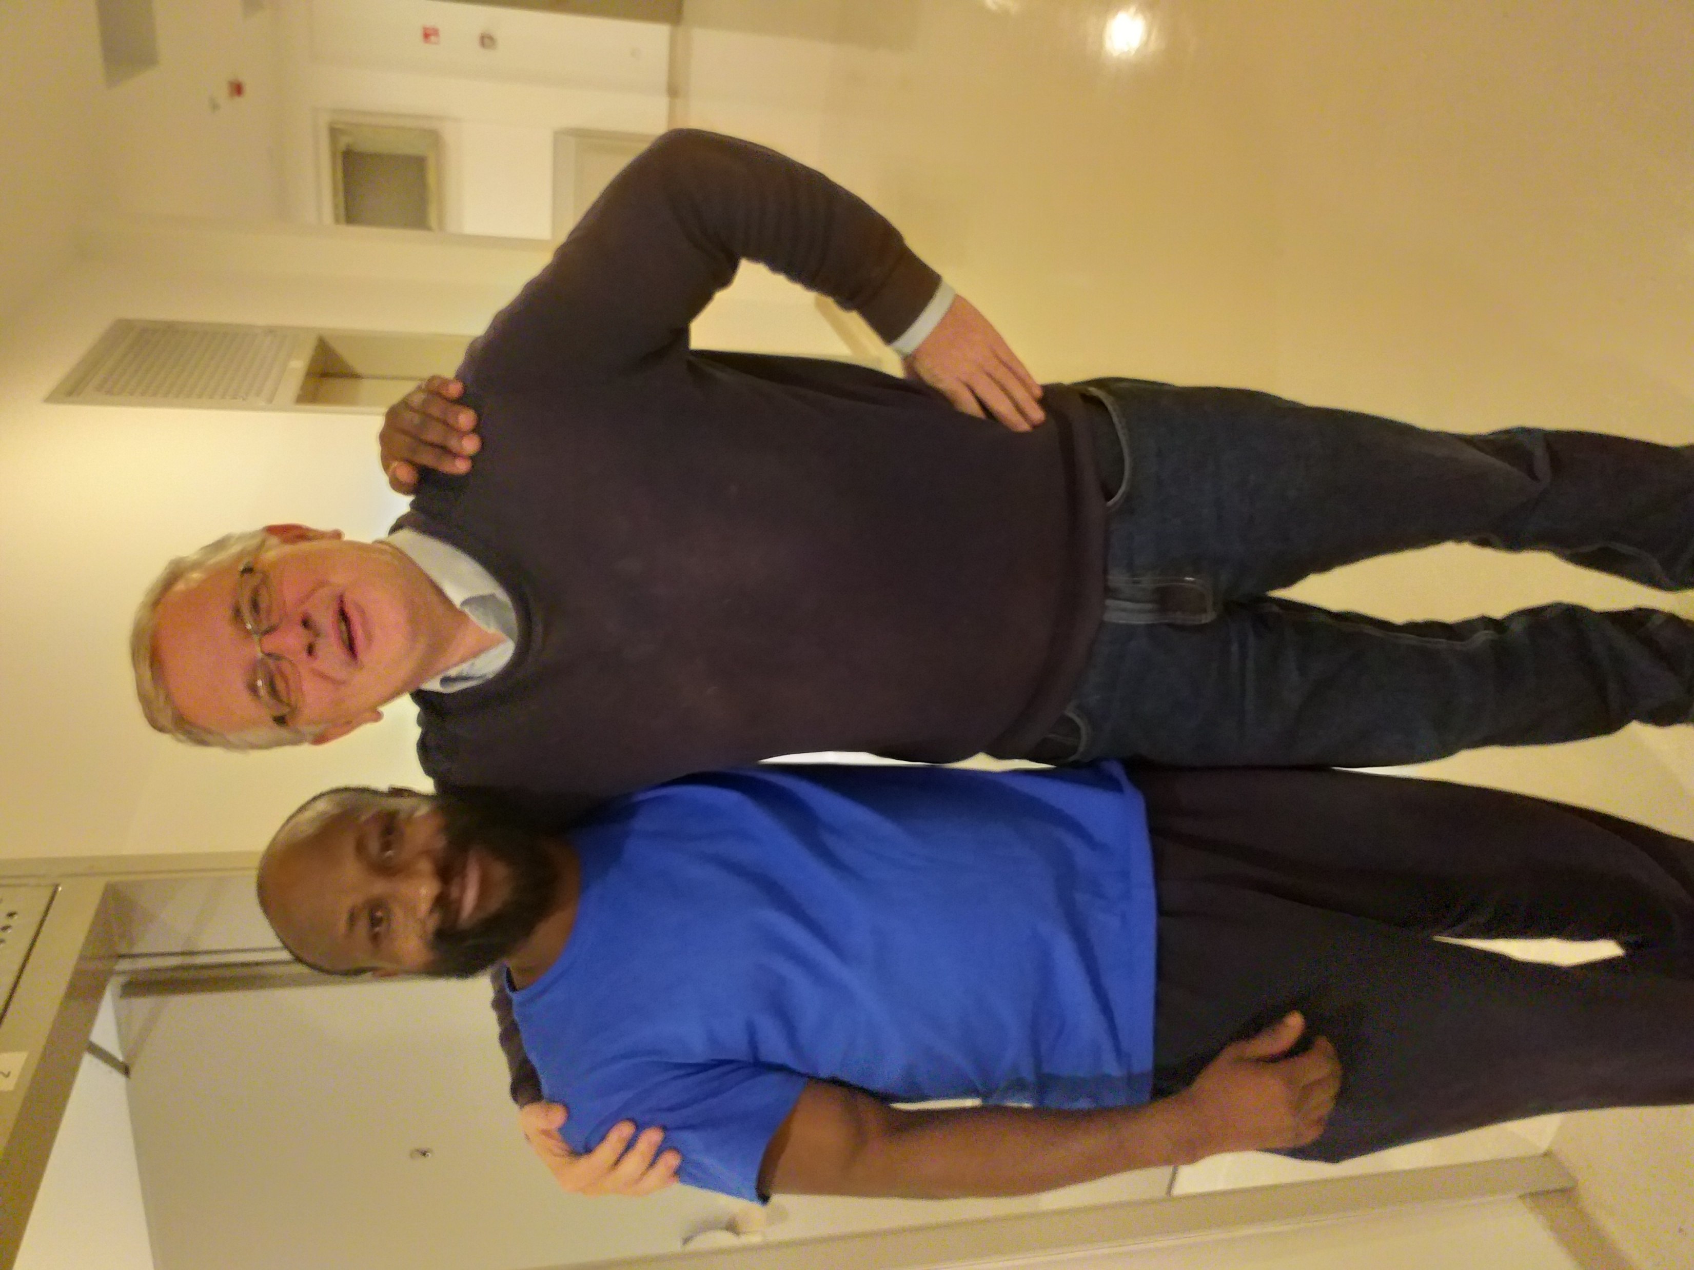
Helping asylum seekers
Preparation of the bag with the essentil things for life in the asylum home
Direct help to the people
Personal contact with asylum seekers
"D:\Moje slike\jrs\20221109_200758.jpg"

