Slide 1
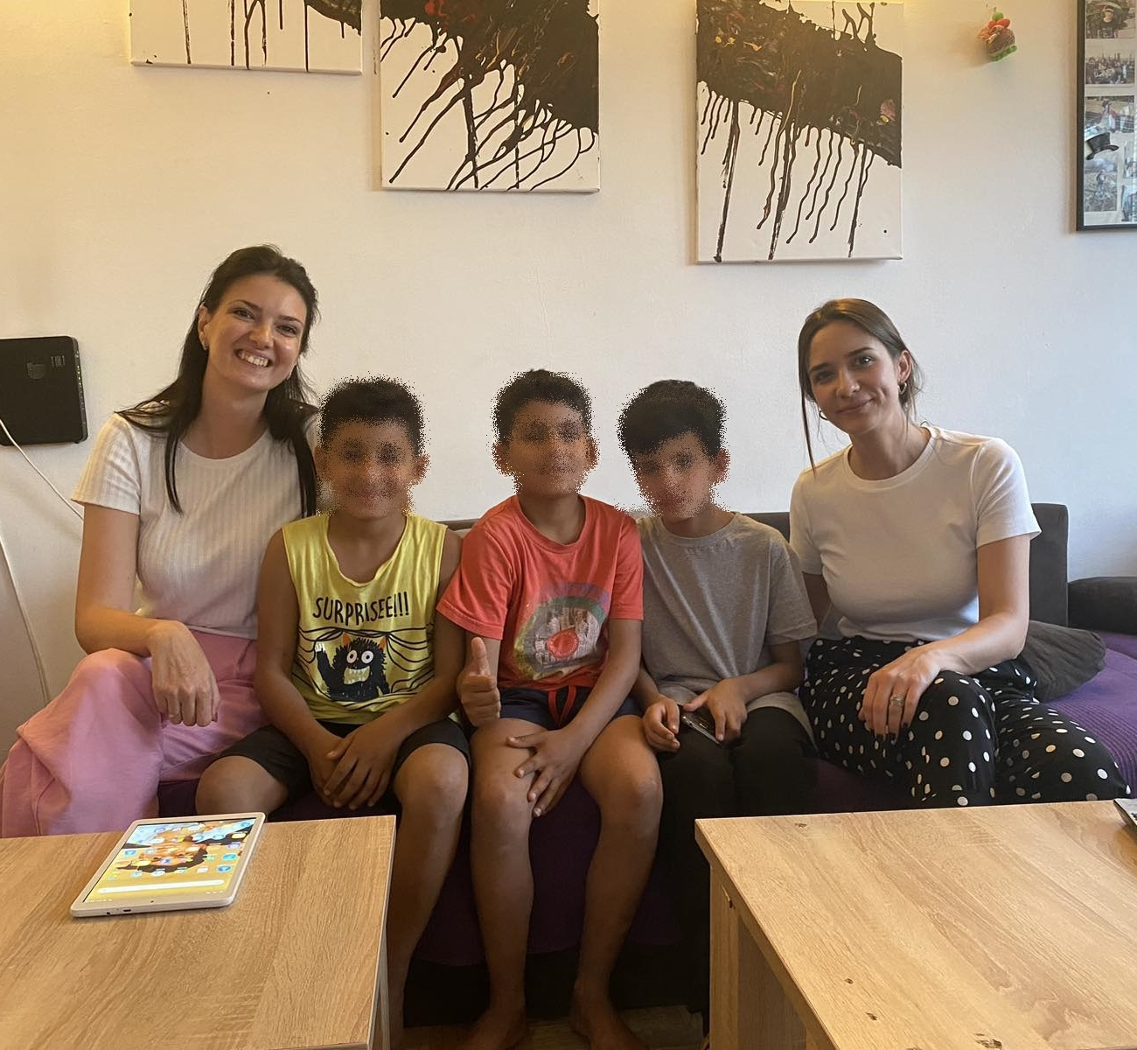


Integration House
“Pedro Arrupe” (2017-2024)
Key aspects that contributed to effectiveness:
Strong social need for shelter for child refugees
Services that were going beyond simple shelter services - focus on education and integration in the family-like environment
Committed team

Slide 2
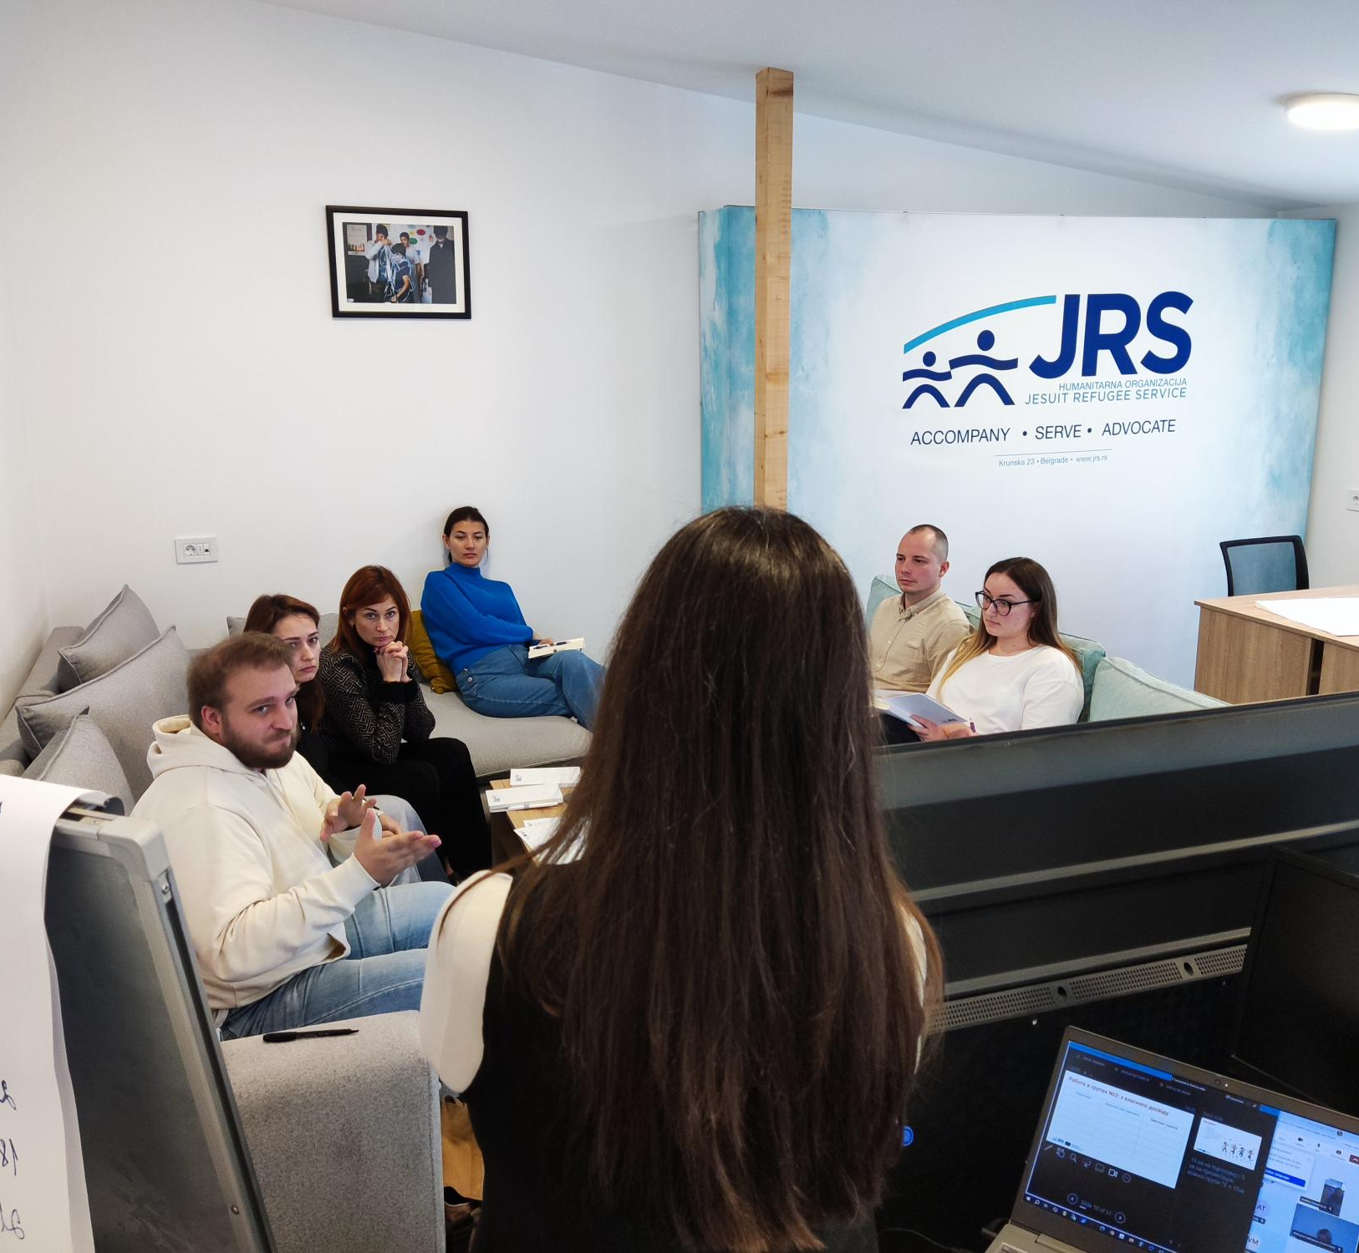

Community Center for Refugee Integration (CCRI)
Key aspects that contributed to effectiveness:
Established as a place of gathering of refugees
Team experience - services tailored for target group beneficiaries
Following changes and refugees' issues in Serbia and in the region

