Slide 1
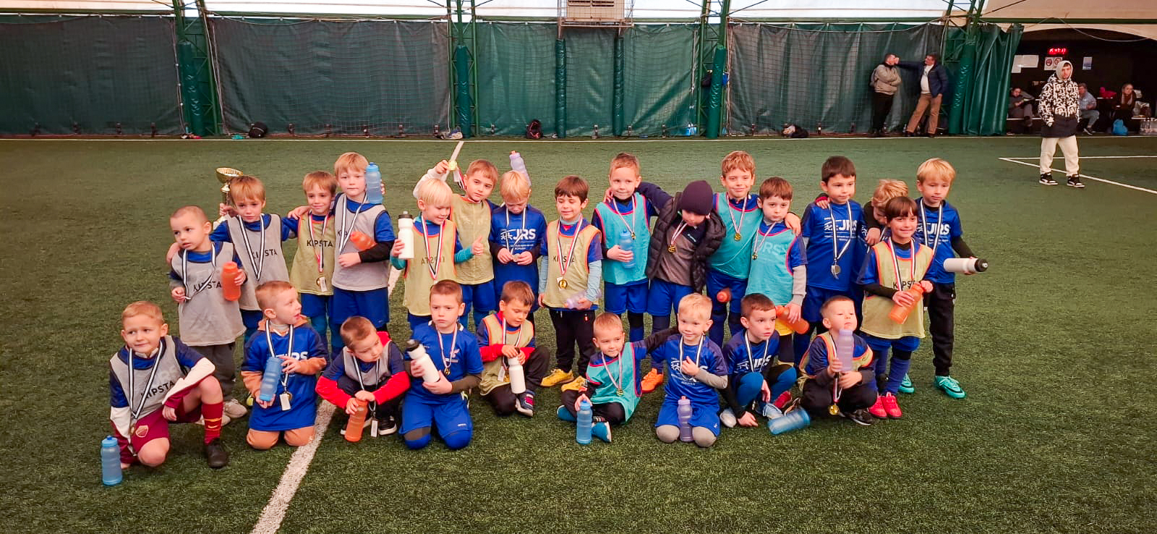
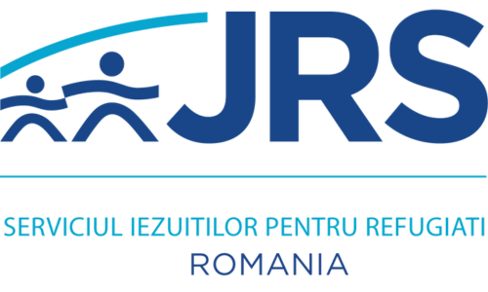
One Proposal
(JRS Europe)
1. FLEXIBILITY (REAL-TIME, NEEDS-BASED ASSISTANCE)
Unlike rigid project frameworks with predefined, inflexible interventions, One Proposal allowed JRS Romania to adapt dynamically to the evolving needs of beneficiaries.
This flexibility meant that instead of providing standardized support, we were able to offer exactly what was needed, when it was needed—whether it was emergency aid, legal support, psychosocial assistance, or housing solutions.
Example of impact: When unexpected crises arose (e.g., new refugee waves or sudden legal/policy changes), JRS Romania was able to redirect resources in real-time, ensuring that beneficiaries received meaningful and timely assistance.
2. CONTINUITY (MULTI-YEAR APPROACH)
The project’s three-year planning framework ensured gradual, phased interventions, addressing refugee needs at different stages of their journey:
  Year 1: Emergency response – immediate shelter, food, medical support, legal aid.
  Year 2: Integration efforts – language courses, employment support, social inclusion programs.
  Year 3: Targeted assistance for the most vulnerable groups – specialized support for unaccompanied minors, survivors of gender-based violence, and persons with disabilities.
Compared to short-term, one-year projects that often struggle with sustainability, this approach allowed us to build upon each stage, ensuring long-term impact rather than just short-term relief.
3. COMMUNITY BUILDING: JRS AS MORE THAN JUST A SERVICE PROVIDER
One Proposal fostered a sense of belonging and community among beneficiaries rather than a transactional "aid provider-recipient" relationship.
This shift in perception strengthened JRS’s role beyond emergency response—positioning it as a community anchor for long-term refugee inclusion and advocacy.

Slide 2

Little Seeds of Hope
(CAFOD)
1. A DONOR THAT UNDERSTANDS THE REALITIES ON THE GROUND
Unlike donors who impose rigid frameworks, this donor operates with deep field awareness, trusting JRS Romania’s expertise and direct experience with refugees.
The relationship is based on mutual respect and open dialogue, where JRS is not just an implementer of predefined activities, but a strategic actor helping shape the program.
This allows for practical, real-world solutions instead of bureaucratic inefficiencies.
2. A DONOR THAT INVESTS IN ORGANIZATIONAL GROWTH (CAPACITY BUILDING)
Beyond funding project activities, this donor actively supports JRS Romania’s long-term institutional development by strengthening:
  Fundraising capacity
  Advocacy
  Financial management & sustainability
Compared to traditional donors who focus solely on project implementation, this approach ensures that JRS emerges stronger, more autonomous, and better prepared for future challenges.
3. A DONOR THAT FOCUSES ON CONTINUITY, NOT JUST EXIT STRATEGIES
Unlike donors who prioritize short-term funding with a rigid exit plan, this donor seeks strategies for sustainable impact and long-term presence.
JRS is actively involved in these discussions, ensuring that transition plans are collaborative, realistic, and aligned with the needs of refugees.
Instead of abruptly withdrawing, the donor works on sustainability mechanisms, such as: multi-year funding models, advocacy for continued policy support, strengthening local partnerships for shared responsibility.

