Slide 1
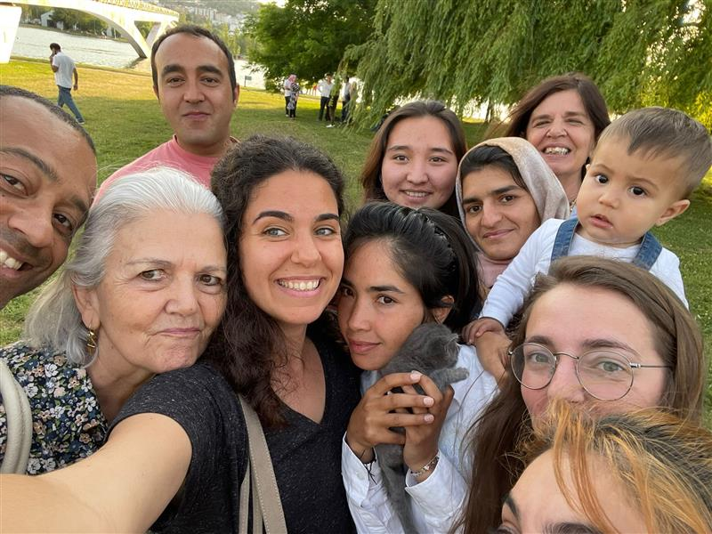

Communities of Hospitality
Local communities as privileged agents of social inclusion;
Awareness raising agents;
Flexible model;
Geographical decentralization
2024:
111 Refugees accompanied
50 Volunteers
15 Cities across the country
Notes:
CHs have in-depth knowledge of the local reality where they live, and are the guides for effective community integration. They support knowledge and understanding of the local economy, access to the labor market, the health system and the school system, the identification and use of basic services, the neighborhood and even leisure spaces, and mediate between refugees and members of the community.
These CHs become direct and indirect ambassadors of JRS and of the cause of refugees.
The model is flexible and can easily adapt to the context of each family.
It has allowed to diversify the solutions and resources geographicaly available, without saturating the services in the major urban areas.

Slide 2
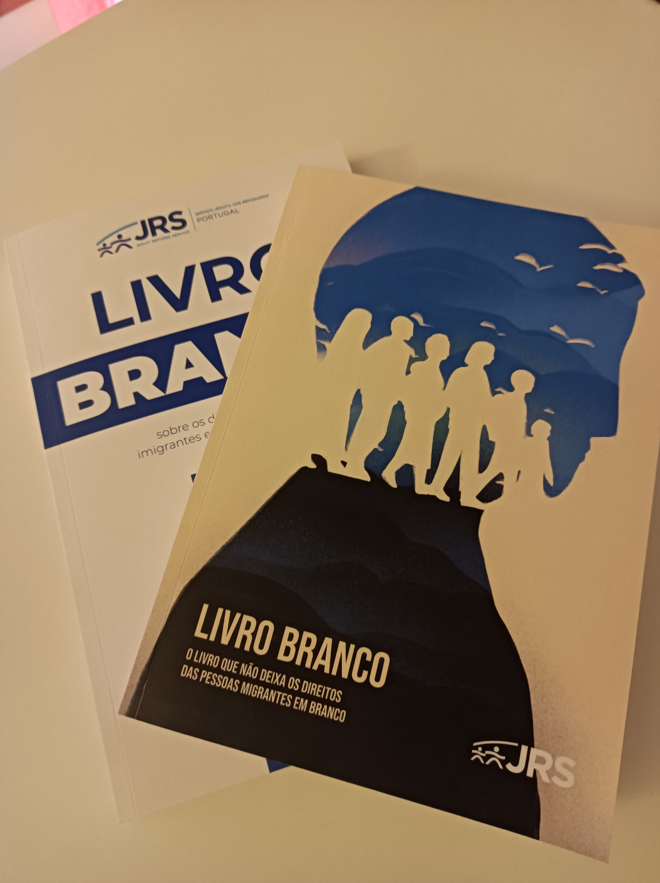

White Paper
Powerful advocacy resource;
Legislatives changes;
Opportunity for internal reflection;
Possible Impact example (amongst others):
Importance of Cultural Mediators in Schools
“Aprender mais Agora” Plan(2024) School recruitment of 287 mediators for this school year
Notes:
The white paper aims to raise awareness among political decision makers and civil society in general, and to make a positive contribution to the removal of obstacles concerning the reception and integration of migrants in Portugal.
2)The government has implemented some of our recommendations through legislative changes.
3)Policy papers also as a thematic advocacy resource.

