Slide 1
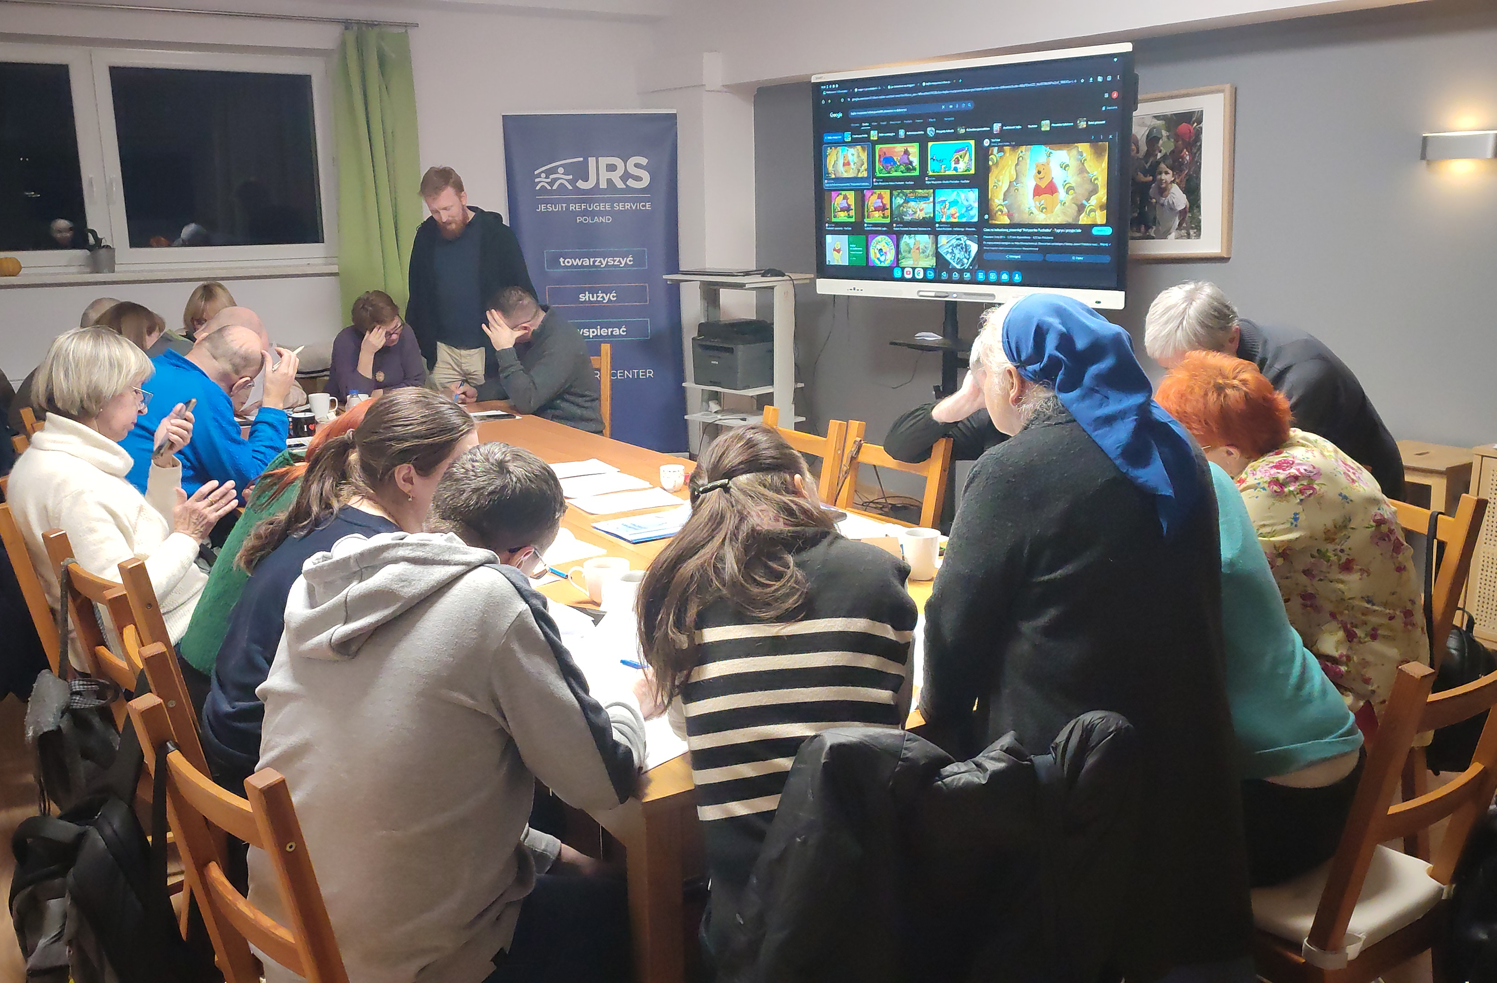
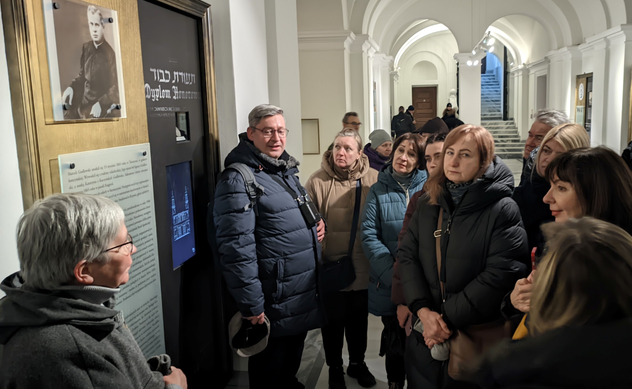

Language Café and Tours (Warsaw)
Patience in walking with refugees at their pace
Discovering resources that they can share (not just take)
The value of informal community among refugees – solidarity shown to each other
Overcoming crises along the way (low turnout, more transparent organization)

Slide 2
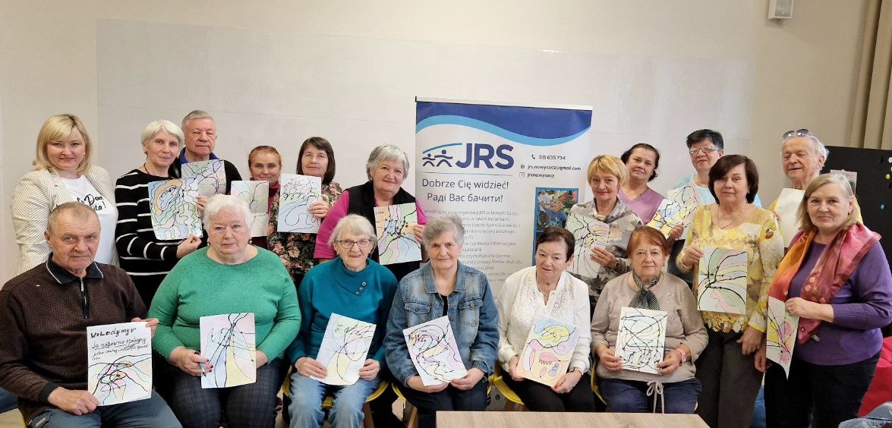
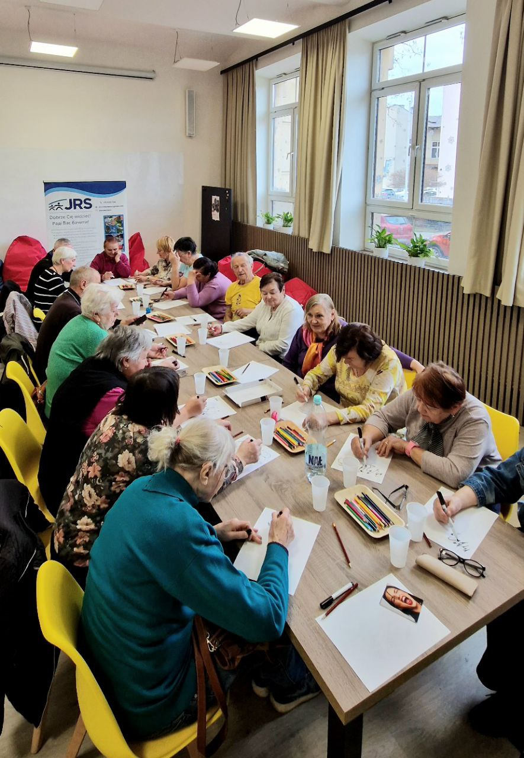
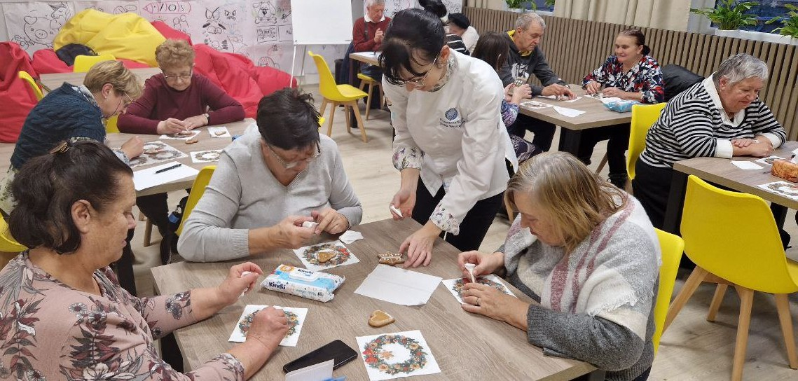
A friendly place for seniors in New Sacz
To cooperate with the Institute of the Third Age through the public library.
To find leaders among senior refugees, maintain contact with them, and coordinate their work as volunteers.
To organize activities focused on the needs of senior refugees.

