Slide 1
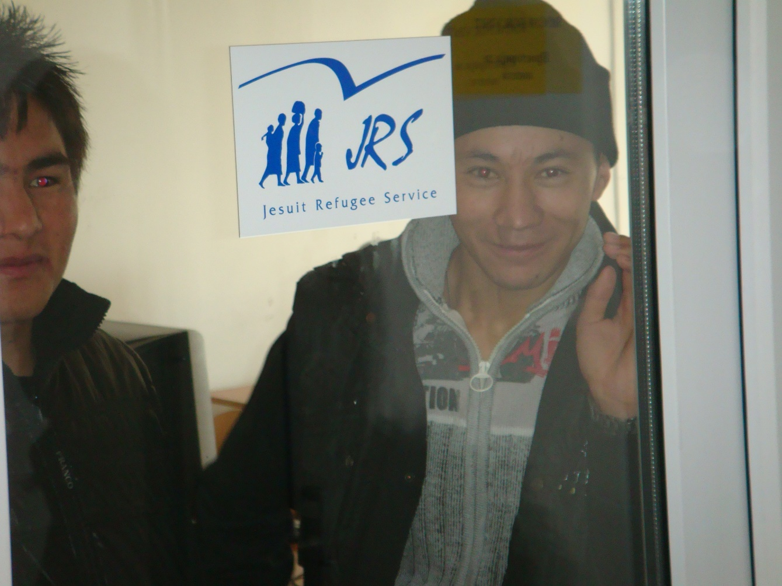

Renovabis/KZE - Improvement of the human rights status of refugees and asylum seekers in North Macedonia 2023-2025
Absence of personal identification number for asylum seekers remains a critical barrier to their fundamental rights.
Need for Strategy for integration of refugees and foreigners and need of system of operation (Who, What, When and How).
Lack of legal reasoning and individual assessment in the Decisions from the Sector for asylum and state-funded interpreters in asylum procedure is still a major gap.
Notes:
Over the years, through the lessons learned from the past, JRS Macedonia has succeeded and continues to succeed in making certain changes in the functioning of the migration and asylum system in Macedonia. HOWEVER, such changes would be in vain and would not have continuity if there were no funds that would directly contribute to the continuity of the work of JRS Macedonia.

Slide 2
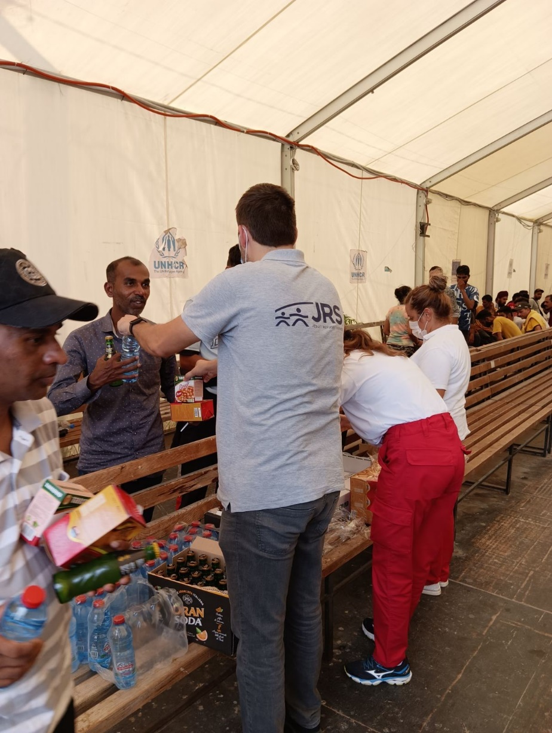
LDS - Providing support and protection to forced migrants in North Macedonia - 2022
Macedonia still entering point for forced migrants (12.255 in 2022)
Sit all stakeholders on common table and discuss and find solutions for beneficiaries.
Improved living conditions and livelihoods for beneficiaries who were detained and with restriction of freedom of movement

