Slide 1
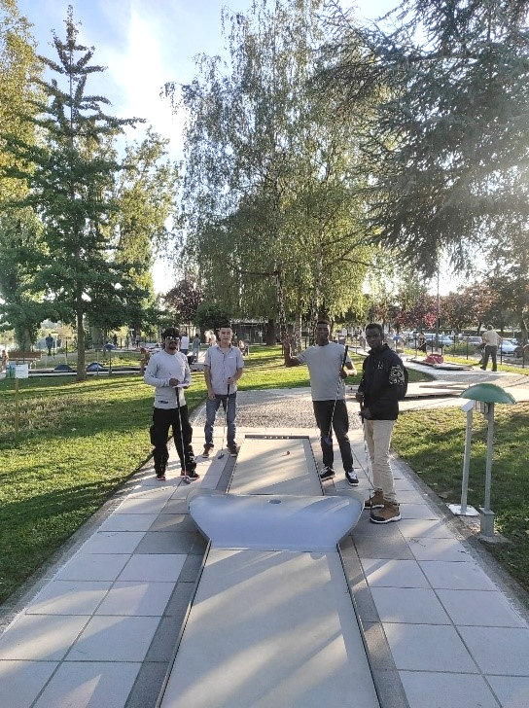


Motiro
Findings
Regularity and variety of activities
A real break from the daily grind -> improved well-being
Good contacts with accommodation facilities

Slide 2
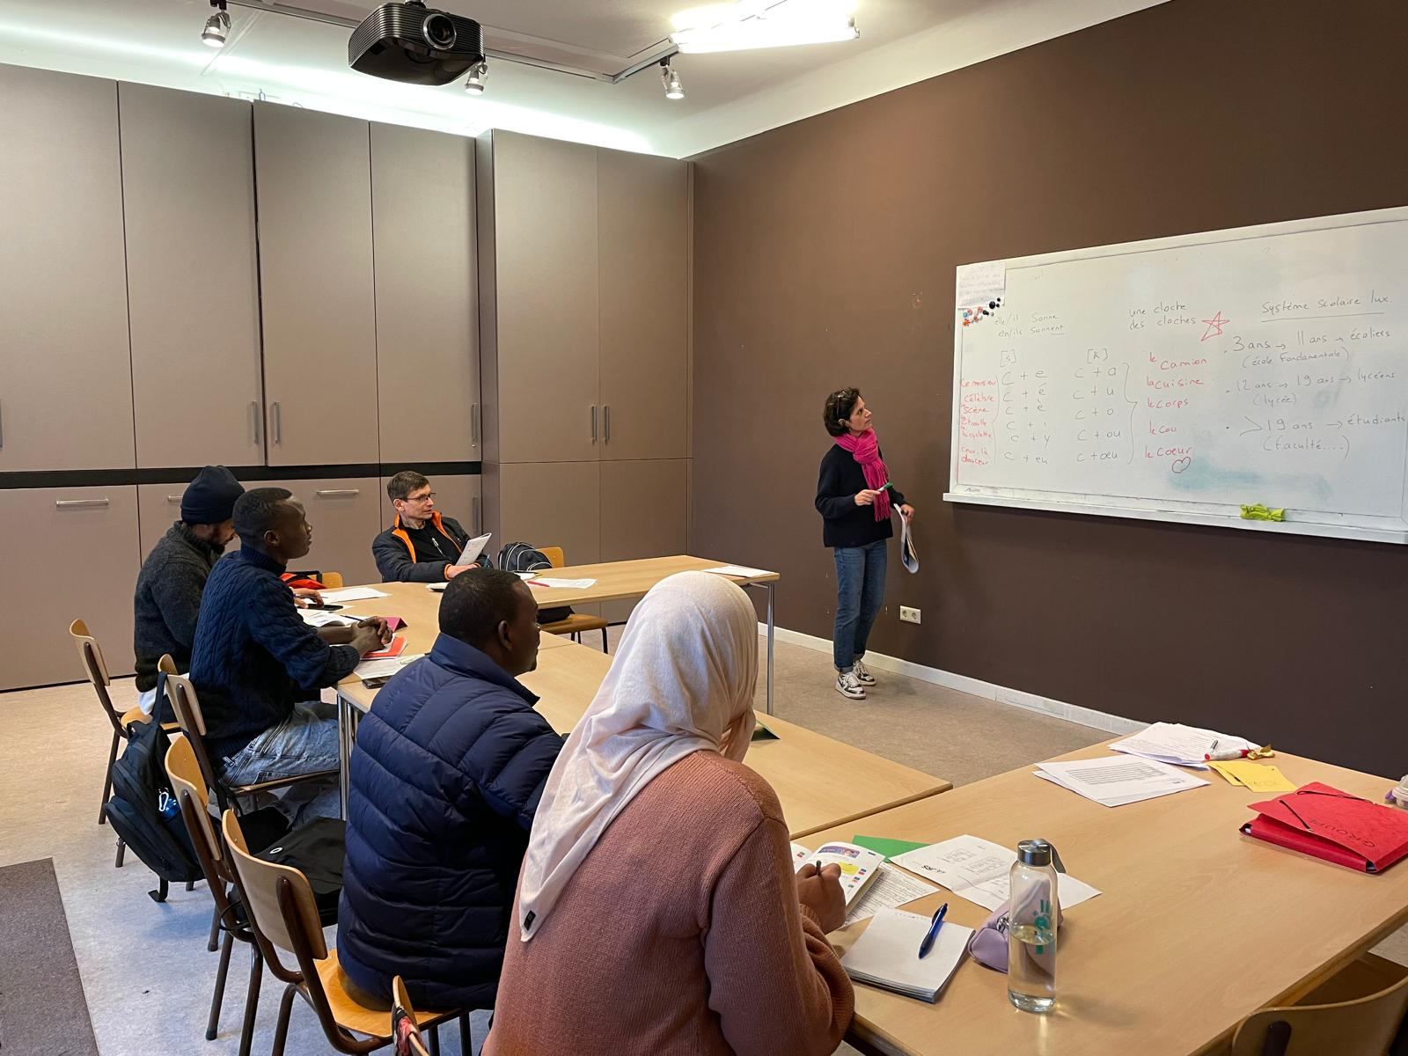
Karibuni
Findings
Very low threshold approach
Contacts with accommodation teams
Personalised follow-up
Summer Camp

