Slide 1
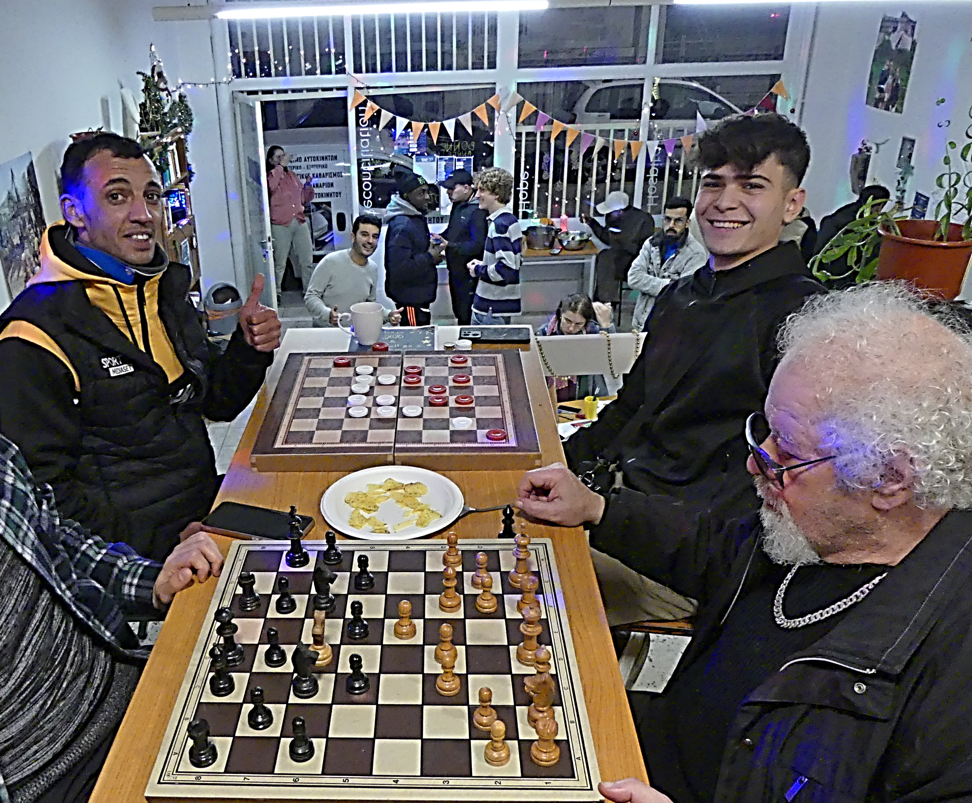

Welcome Center
Key aspects of the Welcome Center's effectiveness are,
The center’s open-door policy for all, regardless of legal status, creates a welcoming environment that encourages participation from refugees and locals. Also, the shift to afternoons improved accessibility.
Activities promote social interaction, break down barriers, and foster mutual understanding, facilitating genuine community building.
Volunteers play a vital role in connecting with beneficiaries, strengthening relationships, and enhancing the center’s support network, making it a more effective and sustainable initiative.

Slide 2
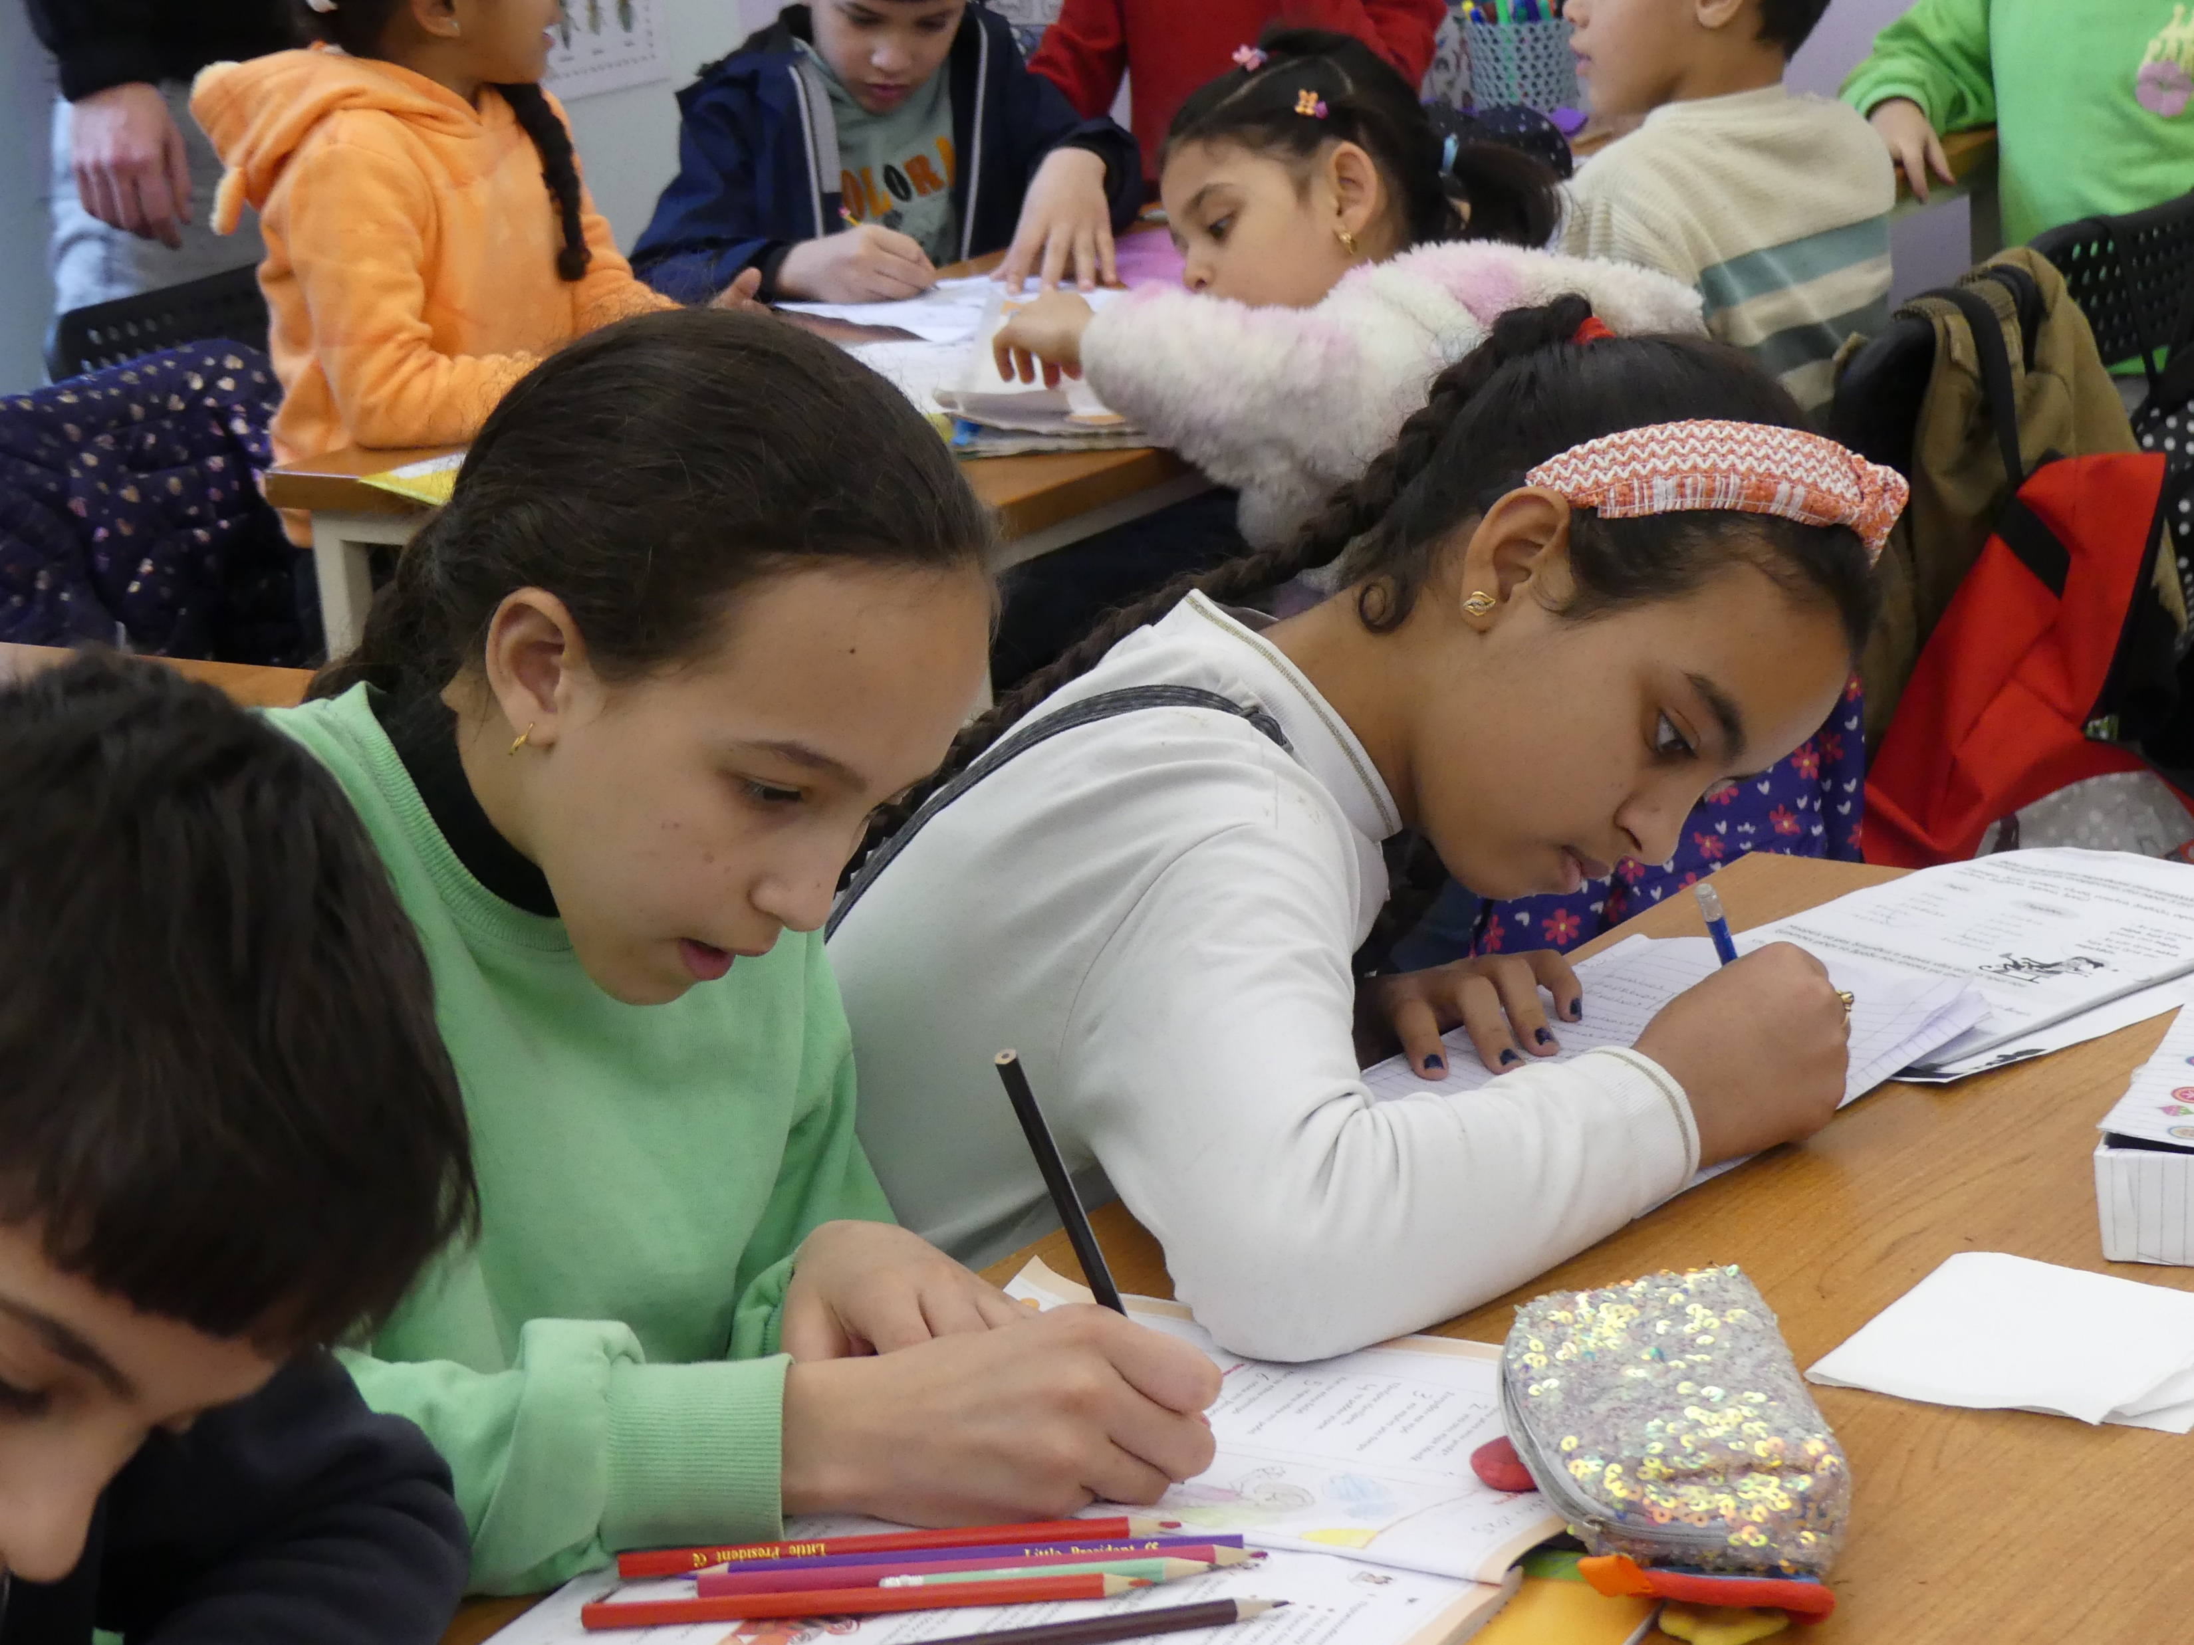
Pedro Arrupe Center
Key aspects of the Pedro Arrupe Center's effectiveness are,
its ability to bridge the gap in the public system’s support for refugee and migrant students. The center's focus ensures that the children, who often face language and cultural barriers, have the support they need to succeed academically and socially.
The provision of intensive Greek language courses to long-term volunteers allows them to participate in the project and discover the challenges that the children face.

